Slide 1

18CSC203J – COMPUTER ORGANIZATION AND ARCHITECTURE
Course Outcome
CLR-1:Utilize the functional units of a computer
CLO-1 :Identify the computer hardware and how software interacts with computer hardware

Slide 2
Topics Covered
Functional Units of a computer
Operational Concepts
Bus Structures
Memory Location and Addresses
Memory Operations
Instructions and Instruction Sequencing
Addressing modes
Problem Solving
Introduction to Microprocessor
Introduction to Assembly Language
Writing of Assembly Language Programming
ARM Processor: The Thumb instruction set
Processor and CPU CORES
Instruction Encoding Format
Memory load and store instruction in ARM
Basics of IO Operations

Slide 3
What is a computer?
a computer is a sophisticated electronic calculating machine that:
Accepts input information,
Processes the information according to a list of internally stored instructions and
Produces the resulting output information.
Functions performed by a computer are:
Accepting information to be processed as input.
Storing a list of instructions to process the information.
Processing the information according to the list of instructions.
Providing the results of the processing as output.
What are the functional units of a computer?

Slide 4
Functional Units of a Computer

Slide 5
FUNCTIONAL UNITS OF COMPUTER
Input Unit
Output Unit
Central processing Unit (ALU and Control Units)
Memory
Bus Structure

Slide 6
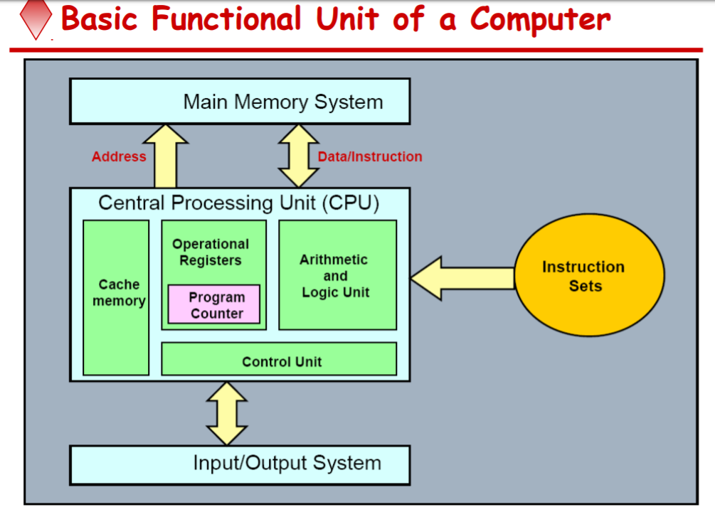

Slide 7
Functions
ALL computer functions are:
Data PROCESSING
Data STORAGE
Data MOVEMENT
CONTROL
Data = Information
Coordinates How Information is Used

Slide 8
Functions of a computer
The operations performed by a computer using the functional units can be summarized as follows:
It accepts information (program and data) through input unit and transfers it to the memory.
Information stored in the memory is fetched, under program control, into an arithmetic and logic unit for processing.
Processed information leaves the computer through an output unit.
The control unit controls all activities taking place inside a computer.

Slide 9
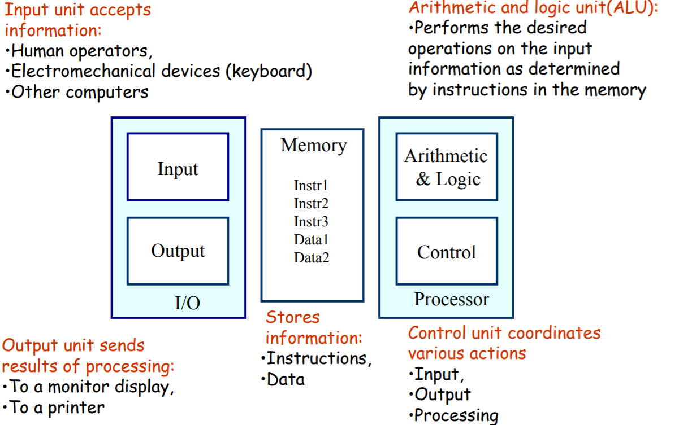

Slide 10
Information in a computer -- Instructions
Instructions specify commands to:
Transfer information within a computer (e.g., from memory to ALU)
Transfer information between the computer and I/O devices (e.g., from keyboard to computer, or computer to printer)
Perform arithmetic and logic operations (e.g., Add two numbers, Perform a logical AND).
A sequence of instructions to perform a task is called a program, which is stored in the memory.
Processor fetches instructions that make up a program from the memory and performs the operations stated in those instructions.

Slide 11
Information in a computer -- Data
Data are the “operands” upon which instructions operate.
Data could be:
Numbers,
Encoded characters.
Data, in a broad sense means any digital information.
Computers use data that is encoded as a string of binary digits called bits.

Slide 12
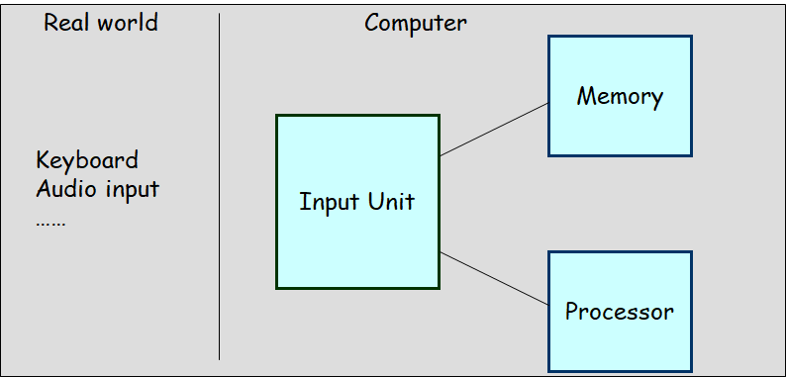
Input unit
Binary information must be presented to a computer in a specific format. This
task is performed by the input unit:
- Interfaces with input devices.
- Accepts information from the input devices.
- Presents this binary information in a format expected by the computer.
- Transfers this information to the memory or processor.

Slide 13
Memory unit
Memory unit stores instructions and data.
Recall, data is represented as a series of bits.
To store data, memory unit thus stores bits.
Processor reads instructions and reads/writes data from/to the memory during the execution of a program.
a group of bits is fetched at a time.
Group of bits stored or retrieved at a time is termed as “word”
Number of bits in a word is termed as the “word length” of a computer.
In order to read/write to and from memory, a processor should know where to look:
“Address” is associated with each word location.

Slide 14
Memory unit (contd..)
Processor reads/writes to/from memory based on the memory address:
Access any word location in a short and fixed amount of time based on the address.
Random Access Memory (RAM) provides fixed access time independent of the location of the word.
Access time is known as “Memory Access Time”.
Memory and processor have to “communicate” with each other in order to read/write information.
In order to reduce “communication time”, a small amount of RAM (known as Cache) is tightly coupled with the processor.
Modern computers have three to four levels of RAM units with different speeds and sizes:
Fastest, smallest known as Cache
Slowest, largest known as Main memory.
Notes:
Since the instructions and data need to be feteched from the memory in order to perform a task, the time it takes to access and fetch this information will be one factor influencing how fast a given task will complete. In order to increase the speed of performing a task, one way is to reduce the amount of time it takes to fetch the data and the instructions. This time is called as “access time”.
Suppose if we want to fetch the data at memory location with the address 10. In case of sequential access, we have to access locations 1-9, and then access location 10. Clearly, in case of sequential access the access times increase as memory locations with higher access times are accessed. We need some kind of memory which provides fixed and short access time irrespective of the memory location being accessed. That is, it provides random access.
Why is the access time faster for the Cache than it is for primary storage? I haven’t yet discussed how the various units communicate with each other. In a few minutes I will discuss that, and it will become clear.

Slide 15
Memory unit (contd..)
Primary storage of the computer consists of RAM units.
Fastest, smallest unit is Cache.
Slowest, largest unit is Main Memory.
Primary storage is insufficient to store large amounts of data and programs.
Primary storage can be added, but it is expensive.
Store large amounts of data on secondary storage devices:
Magnetic disks and tapes,
Optical disks (CD-ROMS).
Access to the data stored in secondary storage in slower, but take advantage of the fact that some information may be accessed infrequently.
Cost of a memory unit depends on its access time, lesser access time implies higher cost.

Slide 16
Arithmetic and logic unit (ALU)
Operations are executed in the Arithmetic and Logic Unit (ALU).
Arithmetic operations such as addition, subtraction.
Logic operations such as comparison of numbers.
In order to execute an instruction, operands need to be brought into the ALU from the memory.
Operands are stored in general purpose registers available in the CPU.
Access times of general purpose registers are faster than the cache.
Results of the operations are stored back in the memory or retained in the processor for immediate use.

Slide 17
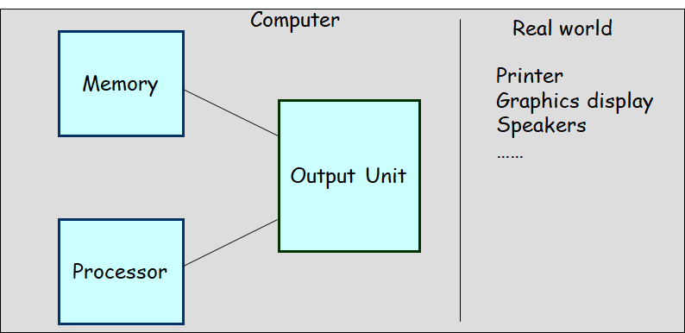
Output unit
Computers represent information in a specific binary form. Output units:
- Interface with output devices.
- Accept processed results provided by the computer in specific binary form.
- Convert the information in binary form to a form understood by an
output device.

Slide 18
Control unit
Operation of a computer can be summarized as:
Accepts information from the input units (Input unit).
Stores the information (Memory).
Processes the information (ALU).
Provides processed results through the output units (Output unit).
Operations of Input unit, Memory, ALU and Output unit are coordinated by Control unit.
Instructions control “what” operations take place (e.g. data transfer, processing).
Control unit generates timing signals which determines “when” a particular operation takes place.

Slide 19
CPU (Central processing Unit)
The “brain” of the machine
Responsible for carrying out computational task
Contains ALU, CU, Registers
ALU Performs Arithmetic and logical operations
CU Provides control signals in accordance with some timings which in turn controls the execution process
Register Stores data and result and speeds up the operation

Slide 20
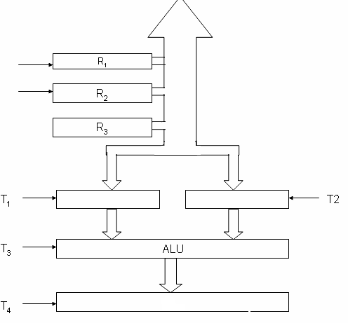
CONTROL UNIT
Control unit works with a reference signal called Processor clock
Processor divides the operations into basic steps
Each basic step is executed in one clock cycle
T1
T2
R1
R2
R2

Slide 21
Example
Add R2, R1
T1
T2
T3
T4
Enable R1
Enable R2
Enable ALU for addition operation
Enable out put of ALU to store result of the operation

Slide 22
Operational Concepts

Slide 23
Basic Operational Concepts
Basic Function of Computer
To Execute a given task as per the appropriate program
Program consists of list of instructions stored in memory

Slide 24
A Typical Instruction
Add R0, LOCA
Add the operand at memory location LOCA to the operand in a register R0 in the processor.
Place the sum into register R0.
The original contents of LOCA are preserved.
The original contents of R0 is overwritten.
Instruction is fetched from the memory into the processor – the operand at LOCA is fetched and added to the contents of R0 – the resulting sum is stored in register R0.

Slide 25
Load R2, LOC
This instruction reads the contents of a memory location by the label LOC and loads them into processor register R2.
The original contents of location LOC are preserved, whereas those of register R2 are overwritten.
Execution of this instruction requires several steps.
First, the instruction is fetched from the memory into the
processor.
Next, the operation to be performed is determined by the control unit.
The operand at LOC is then fetched from the memory into the processor.
Finally, the operand is stored in register R2

Slide 26
Add R4, R2, R3
adds the contents of registers R2 and R3, then places their sum into register R4.
The operands in R2 and R3 are not altered, but the previous value in R4 is overwritten by the sum.
Store R4, LOC
This instruction copies the operand in register R4 to memory location LOC.
The original contents of location LOC are overwritten, but those of R4 are preserved.
For Load and Store instructions, transfers between the memory and the processor are initiated by sending the address of the desired memory location to the memory unit and asserting the appropriate control signals.
The data are then transferred to or from the memory.

Slide 27
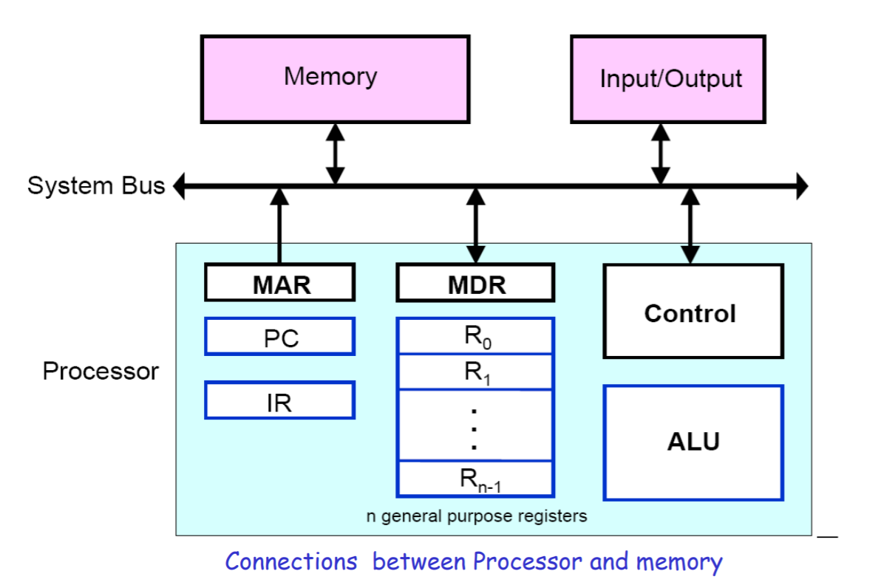

Slide 28
Registers
Registers are fast stand-alone storage locations that hold data temporarily. Multiple registers are needed to facilitate the operation of the CPU. Some of these registers are
Two registers - MAR (Memory Address Register) and MDR (Memory Data Register) : To handle the data transfer between main memory and processor. MAR-Holds addresses, MDR-Holds data
Instruction register (IR) : Hold the Instructions that is currently being executed
Program counter (PC) : Points to the next instructions that is to be fetched from memory
General-purpose Registers: are used for holding data, intermediate results of operations. They are also known as scratch-pad registers.

Slide 29
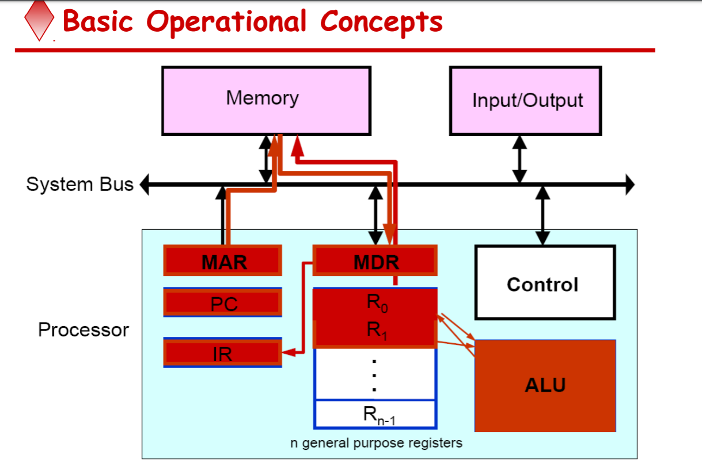

Slide 30
Instruction Fetch – Steps Involved
Program gets into the memory through an input device.
Execution of a program starts by setting the PC to point to the first instruction of the program.
The contents of PC are transferred to the MAR and a Read control signal is sent to the memory.
The addressed word (here it is the first instruction of the program) is read out of memory and loaded into the MDR.
The contents of MDR are transferred to the IR for instruction decoding

Slide 31
Instruction Execution – Steps Involved
The operation field of the instruction in IR is examined to determine the type of operation to be performed by the ALU.
The specified operation is performed by obtaining the operand(s) from the memory locations or from GP registers.
1) Fetching the operands from the memory requires sending the memory location address to the MAR and initiating a Read cycle.
2) The operand is read from the memory into the MDR and then from MDR to the ALU.

Slide 32
Instruction Execution – Steps Involved (Contd..)
3) The ALU performs the desired operation on one or more operands 13 fetched in this manner and sends the result either to memory location or to a GP register.
4) The result is sent to MDR and the address of the location where the result is to be stored is sent to MAR and Write cycle is initiated.
Thus, the execute cycle ends for the current instruction and the PC is incremented to point to the next instruction for a new fetch cycle.

Slide 33
Interrupt
An interrupt is a request from I/O device for service by processor
Processor provides requested service by executing interrupt service routine (ISR)
Contents of PC, general registers, and some control information are stored in memory .
When ISR completed, processor restored, so that interrupted program may continue

Slide 34
Bus Structures

Slide 35
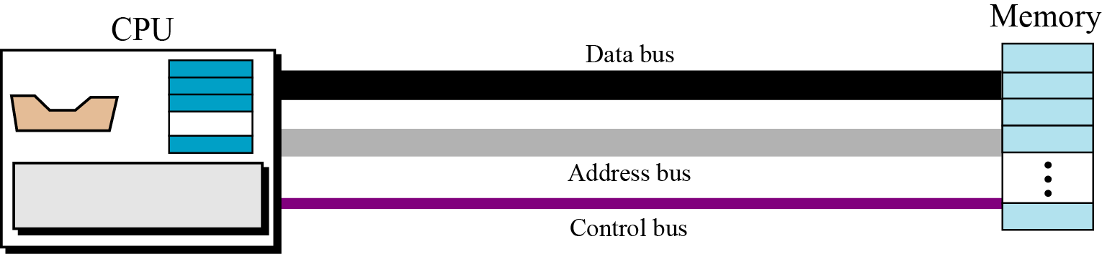
Connecting CPU and memory
The CPU and memory are normally connected by three groups of connections, each called a bus
Group of wires which carries information from CPU to peripherals or vice – versa.
data bus, address bus and control bus
Connecting CPU and memory using three buses

Slide 36
BUS STRUCTURE
Single bus structure: Common bus used to communicate between peripherals and microprocessor
Single Bus Structure
INPUT
MEMORY
PROCESSOR
OUTPUT

Slide 37
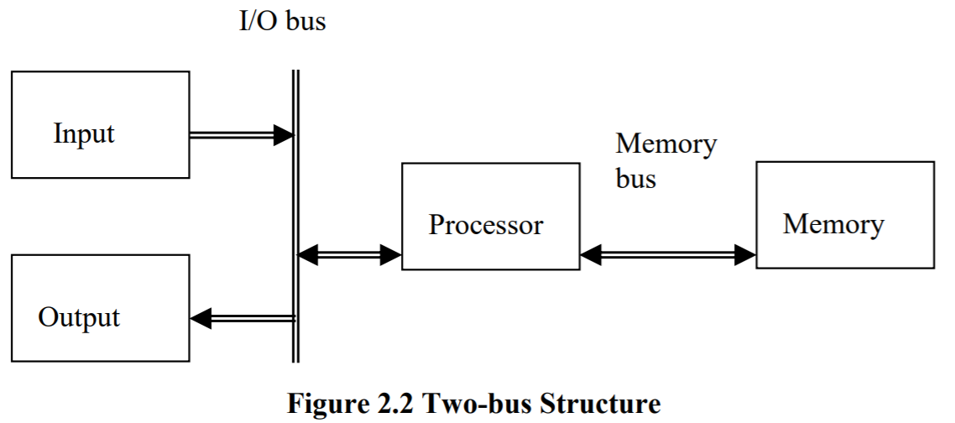
TWO BUS STRUCTURE:
One bus can be used to fetch instruction other can be used to fetch data, required for execution.
The bus is said to perform two distinct functions
The main advantage of this structure is good operating speed but on account of more cost.

Slide 38
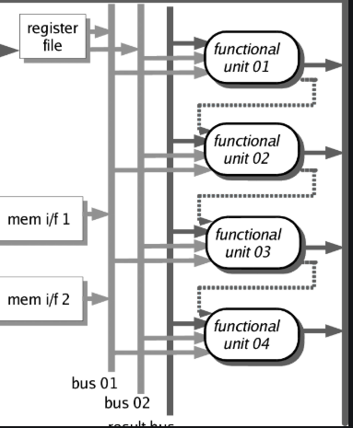
MULTI BUS STRUCTURE
To improve performance multi bus structure can be used.

Slide 39
CONTROL BUS
A₂ | A₁ | A₀ | Selected location
0 | 0 | 0 | 0th Location
0 | 0 | 1 | 1st Location
0 | 1 | 0
0 | 1 | 1
1 | 0 | 0
1 | 0 | 1
1 | 1 | 0
1 | 1 | 1
W/R
CS
RD
A0
A1
A2
PROCESSOR
ADDRESS BUS
D7
D0
D0
D7
DATA BUS

Slide 40
2³ = 8 i.e. 3 address line is required to select 8 location
In general 2^{x} = n where x number of address lines (address bit) and n is number of location
Address bus : unidirectional : group of wires which carries address information bits from processor to peripherals (16,20,24 or more parallel signal lines)
Data bus: bidirectional : group of wires which carries data information bit from processor to peripherals and vice – versa
Control bus: bidirectional: group of wires which carries control signals from processor to peripherals and vice – versa

Slide 41
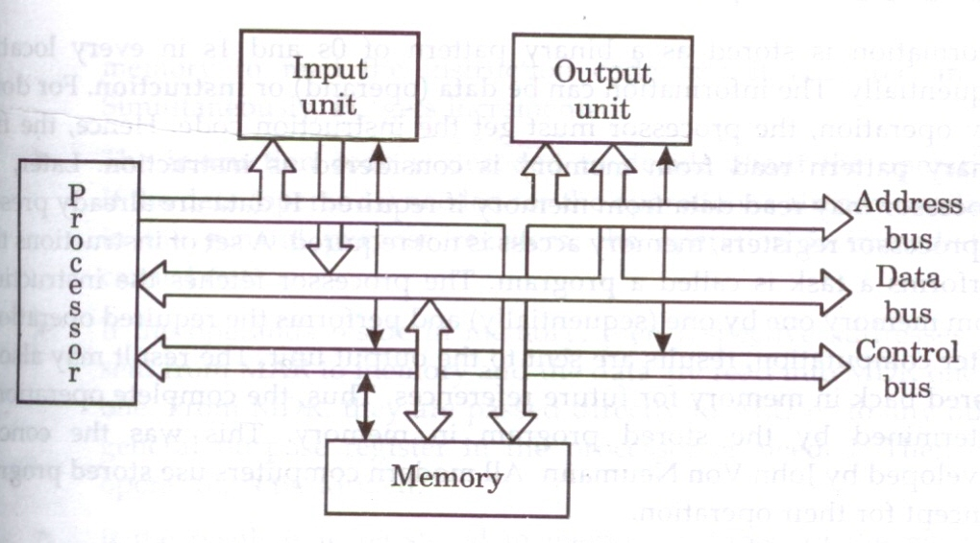
Figure below shows address, data and control bus and their connection with peripheral and microprocessor
Single bus structure showing the details of connection

Slide 42
Memory Locations and Addresses
Notes:
42

Slide 43
Memory Location and Addresses
Memory consists of many millions of storage cells, each of which can store 1 bit.
Data is usually accessed in n-bit groups. n is called word length.
The memory of a computer can be schematically represented as a collection of words as shown in Figure 1.
n
bits
first word
second word
•
•
•
i
th word
•
•
•
last word
Main Memory words.
Notes:
43

Slide 44
Memory Locations And Addresses
Main memory is the second major subsystem in a computer. It consists of a collection of storage locations, each with a unique identifier, called an address.
Data is transferred to and from memory in groups of bits called words. A word can be a group of 8 bits, 16 bits, 32 bits or 64 bits (and growing).
If the word is 8 bits, it is referred to as a byte. The term “byte” is so common in computer science that sometimes a 16-bit word is referred to as a 2-byte word, or a 32-bit word is referred to as a 4-byte word.

Slide 45
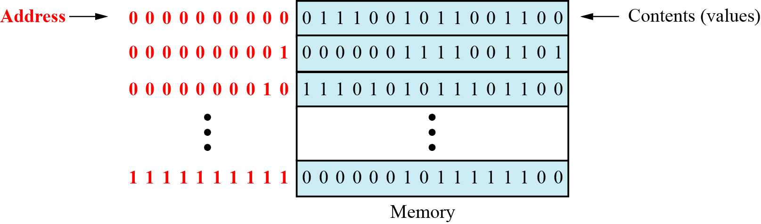
Main memory

Slide 46
Address space
To access a word in memory requires an identifier. Although programmers use a name to identify a word (or a collection of words), at the hardware level each word is identified by an address.
The total number of uniquely identifiable locations in memory is called the address space.
For example, a memory with 64 kilobytes (16 address line required) and a word size of 1 byte has an address space that ranges from 0 to 65,535.

Slide 47
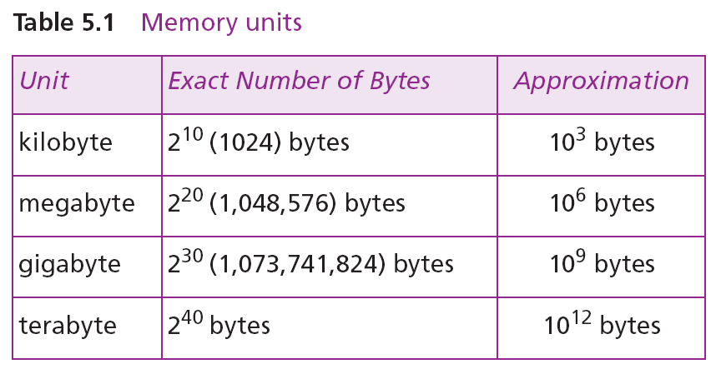
Memory addresses are defined using unsigned binary integers.

Slide 48
Memory
Holds both instructions and data
With k address bits and n bits per location address
k | Number of locations
10 | ₂10 | = 1024 = 1K
16 | ₂16 | = 65,536 = 64K
20 | ₂20 | = 1,048,576 = 1M
24 | ₂24 | = 16,777,216 = 16M
0 n-1
1
2
. . .
1 0
.
.
.
k
2 -1
n is typically 8 (byte), 16 (word), 32 (long word), ….

Slide 49
Example 1
A computer has 32 MB (megabytes) of memory. How many bits are needed to address any single byte in memory?
Solution
The memory address space is 32 MB, or 2²⁵ (2⁵ × 2²⁰). This means that we need log₂ 2²⁵, or 25 bits, to address each byte.
Example 2
A computer has 128 MB of memory. Each word in this computer is eight bytes. How many bits are needed to address any single word in memory?
Solution
The memory address space is 128 MB, which means 2²⁷. However, each word is eight (2³) bytes, which means that we have 2²⁴ words. This means that we need log₂ 2²⁴, or 24 bits, to address each word.

Slide 50
Memory Operations
Today, general-purpose computers use a set of instructions called a program to process data.
A computer executes the program to create output data from input data
Both program instructions and data operands are stored in memory
Two basic operations requires in memory access
Load operation (Read or Fetch)-Contents of specified memory location are read by processor
Store operation (Write)- Data from the processor is stored in specified memory location

Slide 51
Assignment of Byte Address
Big-endian and little-endian are terms that describe the order in which a sequence of bytes are stored in computer memory.
Big-endian is an order in which the "bigend" (most significant value in the sequence) is stored first (at the lowest storage address).
Little-endian is an order in which the “Little end" (least significant value in the sequence) is stored first (at the lowest storage address).

Slide 52
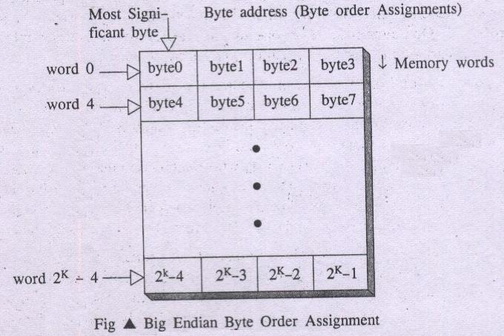
Big endian Assignment

Slide 53
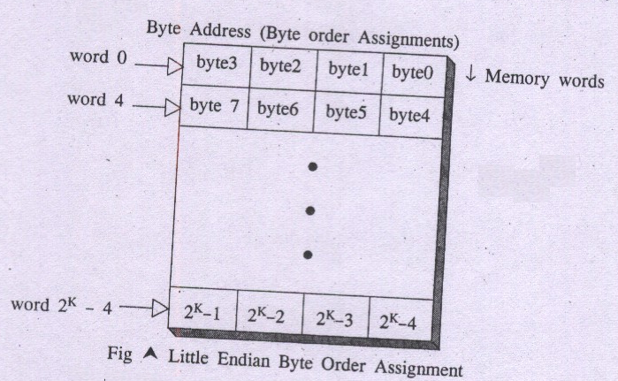
Little – Endian assignment:
In this scheme byte 0 appears as the right most byte of word 0.
Low order bytes represents least significant bytes or right most bytes.

Slide 54
In case of 16 bit data, aligned words begin at byte addresses of 0,2,4,………………………….
In case of 32 bit data, aligned words begin at byte address of 0,4,8,………………………….
In case of 64 bit data, aligned words begin at byte addresses of 0,8,16,………………………..
In some cases words can start at an arbitrary byte address also then, we say that word locations are unaligned

Slide 55
Instruction and instruction sequencing

Slide 56
Introduction
Instruction: is command to the microprocessor to perform a given task on specified data.
Instruction Set: The entire group of these instructions are called instruction set.
instruction sequencing : The order in which the instructions in a program are carried out.
4 TYPES OF OPERATION:-
A computer must have instructions capable of performing 4 types of operation
Data transfer between memory and processor register
Arithmetic and logic operation
Program sequencing and control
I/O transfer

Slide 57
Register transfer notation (RTN)
Transfer between processor registers & memory, between processor register & I/O devices
Memory locations, registers and I/O register names are identified by a symbolic name in uppercase alphabets
LOC,PLACE,MEM are the address of memory location
R1 , R2,… are processor registers
DATA_IN, DATA_OUT are I/O registers
Contents of location is indicated by using square brackets [ ]
RHS of RTN always denotes a values, and is called Source
LHS of RTN always denotes a symbolic name where value is to be stored and is called destination
Source contents are not modified
Destination contents are overwritten

Slide 58
Data transfer Instructions
They are also called copy instructions.
Some instructions in 8086:
MOV -Copy from the source to the destination
LDA - Load the accumulator
STA - Store the accumulator
PUSH - Push the register pair onto the stack
POP - Pop off stack to the register pair

Slide 59
Data Manipulation Instructions
To perform the operations by the ALU
Three categories:
Arithmetic Instructions
Logical and bit manipulation instructions
Shift instructions

Slide 60
Arithmetic Instructions
Used to perform arithmetic operations
Some instruction in 8086
INC ➔ Increment the data by 1
DEC ➔ Decreases data by 1
ADD ➔ perform sum of data
ADC ➔ Add with carry bit.
MUL ➔ perform multiplication

Slide 61
Logical and bit manipulation instructions
Used to perform logical operations
Some instructions are:
AND ➔ bitwise AND operation
OR ➔ bitwise AND operation
NOT ➔ invert each bit of a byte or word
XOR ➔ Exclusive-OR operation over each bit

Slide 62
Shift instructions
used for shifting or rotating the contents of the register
Some instructions are:
SHL: shift bits towards the left and put zero(S) in LSBs
SHR : shift bits towards the right and put zero(S) in MSBs
ROL: rotate bits towards the left, i.e. MSB to LSB
ROR: rotate bits towards the right, i.e. LSB to MSB
RCL: rotate bits towards the left, i.e. MSB to CF and CF to LSB.
RCR: rotate bits towards the right, i.e. LSB to CF and CF to MSB

Slide 63
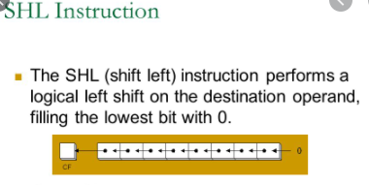
SHL and SHR

Slide 64
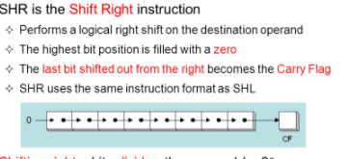

Slide 65
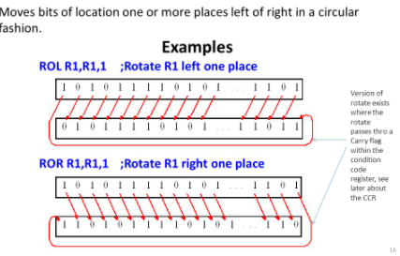

Slide 66
Instruction Formats (Types of instruction based on the address field)
A instruction in computer comprises of groups of fields.
These field contains different information
The most common fields are:
Operation field : specifies the operation to be performed like addition.
Address field : contain the location of operand
Mode field : specifies how to find the operand

Slide 67
An instruction is of various length depending upon the number of addresses it contain.
On the basis of number of address, instruction are classified as:
Zero Address Instructions
One Address Instructions
Two Address Instructions
Three Address Instructions

Slide 68
Three Address Instruction
Syntax: Operation destination, source 1, source 2,
Eg: ADD D,E,F
where D,E,F are memory location
Advantage: Single instruction can perform the complete operation
Disadvantage : Instruction code will be too large to fit in one word location in memory

Slide 69
Three Address Instruction
This has three address field to specify a register or a memory location.
Program created are much short in size
creation of program much easier
does not mean that program will run much faster
Suppose we would like to use a single machine instruction to perform the following addition operation:
S ← [P] + [Q]
We will have to use a three – address instruction to carry out addition and to store the sum in a third variable S.
Then three address instruction to perform addition is:
Add S,P, Q
Example: Evaluate (A+B) ∗ (C+D)
Using Three address Instruction
ADD R1,A,B ;R1=M[A]+M[B]
ADD R2,C,D ;R2=M[C]+M[D]
MUL X,R1,R2 ;M[X]=R1*R2

Slide 70
Two Address Instruction
Syntax : Operation destination, source
Eg: MOVE E,F MOVE D,F
ADD D,F OR ADD E,F
To perform S ← [P] + [Q]
Use two – address instructions sequence: MOVE S, Q
ADD S,P
Perform ADD A,B,C using 2 instructions
MOVE A,C
ADD A,B
Disadvantage: Single instruction is not sufficient to perform the entire operation.

Slide 71
Two Address Instruction
This is common in commercial computers.
Operation Source, Destination
Here two address can be specified in the instruction.
Example: Evaluate (A+B) ∗ (C+D)
Using Two address Instruction:
MOV R1,A ; R1=M[A]
ADD R1,B ;R1=R1+M[B]
MOV R2,C ;R2=M[C]
ADD R2,D ;R2=R2+M[D]
MUL R1,R2 ; R1=R1*R2
MOV X,R1 ; M[X]=R1

Slide 72
One address Instruction
Syntax- Operation source/destination
In this type either a source or destination operand is mentioned in the instruction
Other operand is implied to be a processor register called Accumulator
Eg: ADD B (general)
Load D; ACC [memlocation _D]
ADD E; ACC (ACC) +(E)
STORE F; memlocation_ F (ACC )

Slide 73
One address Instruction
This use a implied ACCUMULATOR register for data manipulation.
Operation Destination
One operand is in accumulator and other is in register or memory location.
Example: Evaluate (A+B) ∗ (C+D)
Using One-Address Instruction
LOAD A ; AC ← M[A]
ADD B ; AC ← AC + M[B]
STORE T ; M[T] ← AC
LOAD C ; AC ← M[C]
ADD D ; AC ← AC + M[D]
MUL T ; AC ← AC ∗ M[T]
STORE X ; M[X] ← AC

Slide 74
Zero Address Instructions
Used in stack based computers which do not use address field in instruction
Location of all operands are defined implicitly
Operands are stored in a structure called pushdown stack

Slide 75
Example: Evaluate (A+B) ∗ (C+D)
Using Zero-Address instruction
PUSH A ; TOS ← A
PUSH B ; TOS ← B
ADD ; TOS ← (A + B)
PUSH C ; TOS ← C
PUSH D ; TOS ← D
ADD ; TOS ← (C + D)
MUL ; TOS ← (C+D)∗(A+B)
POP X ; M[X] ← TOS

Slide 76
Instruction Cycle
the basic operational process of a computer.
also known as fetch-decode-execute cycle
This process is repeated continuously by CPU from boot up to shut down of computer.
steps that occur during an instruction cycle:
1. Fetch the Instruction
2. Decode the Instruction 3. Read the Effective Address
4. Execute the Instruction

Slide 77
1. Fetch the Instruction
The instruction is fetched from memory address that is stored in PC(Program Counter) and stored in the (instruction register) IR.
At the end of the fetch operation, PC is incremented by 1 and it then points to the next instruction to be executed.
2. Decode the Instruction
The instruction in the IR is decoded(Interpreted).
3. Read the Effective Address
Effective address of an operand is computed, the effective address is read from the memory.
Operands are directly read in case of immediate operand instruction.

Slide 78
4. Execute the Instruction
The Control Unit passes the information in the form of control signals to the functional unit of CPU.
The result generated is stored in main memory or sent to an output device.
The cycle is then repeated by fetching the next instruction.
Thus in this way the instruction cycle is repeated continuously.

Slide 79
start
Load address to PC
Load content of PC to IR
Update PC to next address
Execute Instruction
Interrupts
Service Interrupt

Slide 80
Instruction execution and straight line sequencing
Instruction execution needs the following steps, which are
PC (program counter) register of the processor gives the address of the instruction which needs to be fetched from the memory.
If the instruction is fetched then, the instruction opcode is decoded. On decoding, the processor identifies the number of operands. If there is any operand to be fetched from the memory, then that operand address is calculated.
Operands are fetched from the memory. If there is more than one operand, then the operand fetching process may be repeated (i.e. address calculation and fetching operands).
After this, the data operation is performed on the operands, and a result is generated.
If the result has to be stored in a register, the instructions end here.

Slide 81
Straight line sequencing
If the destination is memory, then first the destination address has to be calculated. Then the result is then stored in the memory. If there are multiple results which need to be stored inside the memory, then this process may repeat (i.e. destination address calculation and store result).
Now the current instructions have been executed. Side by side, the PC is incremented to calculate the address of the next instruction.
The above instruction cycle then repeats for further instructions.
Straight line sequencing means the instruction of a program is executed in a sequential manner(i.e. every time PC is incremented by a fixed offset).
And no branch address is loaded on the PC.

Slide 82
Example 1:
First instruction of a program is stored at address i.
PC gives address i and instruction stored at that address i is fetched from the memory and then decoded and then the operand A is fetched from the memory and stored in a temporary register and then the instruction is executed(i.e. content of address A is copied into processor register R0).
the PC gets incremented by 4(i.e. it contains the address of the next instruction) because the instruction and memory segment is of 4 bytes.
So the instruction at address i is executed.
So every time, the PC is incremented by 4. Therefore, the program is executing in a sequential manner. And this process is called straight line sequencing.

Slide 83
Address Contents
Execution Starts here I→ Mov R0,A
I+4→ ADD R0,B
I+8→ MOV C,R0

Slide 84
The addresses of the memory locations containing the n numbers are represented as NUM1,NUM2…..NUMn(i.e. NUM1 address includes first number).
The first number is stored into processor register R0. And every other number is added to register R0. Finally, when the program ends(i.e. n numbers are added, the result is placed in memory location SUM

Slide 85
The second way is to use a loop to add n number. But here straight line sequencing is not used because every time loop iteration ends, PC has to load the branch address and program execution starts from that address.
Here the location N stores the value of n.
Processor register R1 is used as a counter to determine the number of times the loop gets executed.
The contents of the location N are moved into R1 at the start of program execution.
After that, register R0 is cleared.
The address LOOP is reloaded again and again until R1 becomes 0.
Every time a number is added, then the R1 value is decremented.
When R1 becomes 0, we come out of the loop and the result which is stored at R1 is copied into memory location SUM.

Slide 86
Address Contents
Execution Starts here I→ MOV R1,N
I+4→ CLEAR R0
I+8→ LOOP ADD R0,R1
I+12→ DCR R1
I+16→ BRANCH>0 LOOP
I+20→ MOV SUM,R0

Slide 87
Condition Codes
The processor keeps track of information about the results of various operations for use by subsequent conditional branch instructions
N – Negative 1 if results are Negative
0 if results are Positive
Z – Zero 1 if results are Zero
0 if results are Non zero
V – Overflow 1 if arithmetic overflow occurs
0 non overflow occurs
C – Carry 1 if carry and from MSB bit
0 if there is no carry from MSB bit

Slide 88
Addressing Modes

Slide 89
Addressing Modes
Different ways in which the location of the operand is specified in an instruction is referred as addressing modes
The purpose of using addressing mode is:
To give the programming versatility to the user.
To reduce the number of bits in addressing field of instruction.
Types of Addressing Modes
Immediate Addressing
Direct Addressing
Indirect Addressing
Register Addressing
Register Indirect Addressing
Relative Addressing
Indexed Addressing
Auto Increment
Auto Decrement

Slide 90
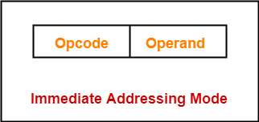
Immediate Addressing
Operand is given explicitly in the instruction
e.g. ADD 5
Add 5 to contents of accumulator
5 is operand
No memory reference to fetch data
Fast
Limited range
MOV AL,25H ; Immediate addressing AL=25
MOV AX,2345H ; AX=2345 AX=> AH=23 AL=45

Slide 91
Direct Addressing
Address field contains address of operand
Effective address (EA) = address field (A)
e.g. ADD A
Add contents of cell A to accumulator
Look in memory at address A for operand
Single memory reference to access data
No additional calculations to work out effective address
Limited address space
MOV AL,DATA1 ; Direct Addressing AL=23
MOV AX,DATA2 ; AX=1234
MOV DATA3,AL ; DATA3=23
MOV DATA4,AX ; DATA4=1234

Slide 92
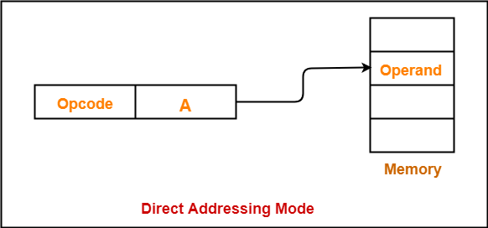

Slide 93
Indirect Addressing
Memory cell pointed to by address field contains the address of (pointer to) the operand
Two references to memory are required to fetch the operand.
Effective Address = [A]
Look in A, find address (A) and look there for operand
e.g. ADD (A)
Add contents of cell pointed to by contents of A to the accumulator
Notes:
7

Slide 94
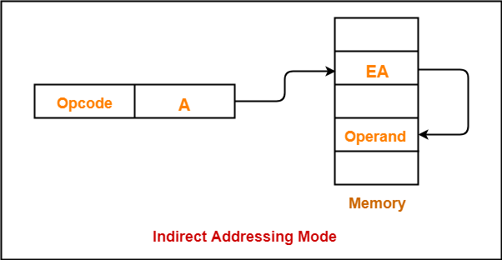

Slide 95
Register Direct Addressing
In this addressing mode,
The operand is contained in a register set.
The address field of the instruction refers to a CPU register that contains the operand.
No memory access
Very fast execution
Very limited address space
Limited number of registers
Very small address field needed
Shorter instructions
Faster instruction fetch
Notes:
10

Slide 96
Register Direct Addressing
Eg:
ADD R will increment the value stored in the accumulator by the content of register R.
AC ← AC + [R]
This addressing mode is similar to direct addressing mode.
The only difference is address field of the instruction refers to a CPU register instead of main memory.
Notes:
11

Slide 97
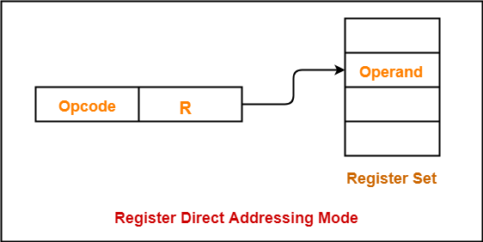

Slide 98
Register Indirect Addressing
The address field of the instruction refers to a CPU register that contains the effective address of the operand.
Only one reference to memory is required to fetch the operand
Eg:
ADD (R) will increment the value stored in the accumulator by the content of memory location specified in register R.
AC ← AC + [[R]]
Notes:
13

Slide 99
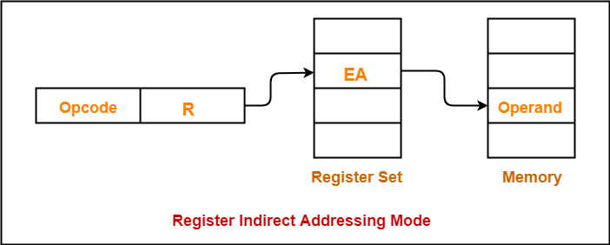

Slide 100
Indexed Addressing
In this addressing mode,
Effective address of the operand is obtained by adding the content of index register with the address part of the instruction.
Effective Address
= Content of Index Register + Address part of the instruction
Notes:
15

Slide 101
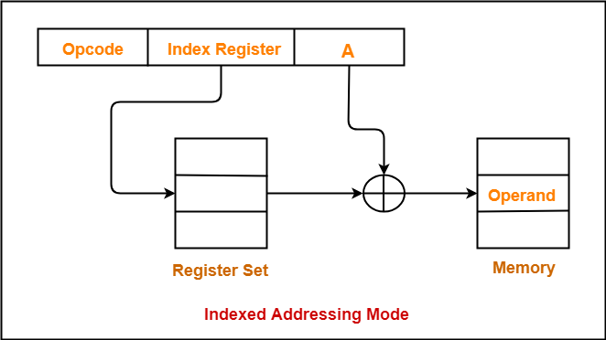

Slide 102
Relative Addressing
A version of displacement addressing
In this addressing mode,
Effective address of the operand is obtained by adding the content of program counter with the address part of the instruction.
Effective Address
= Content of Program Counter + Address part of the instruction
Notes:
17

Slide 103
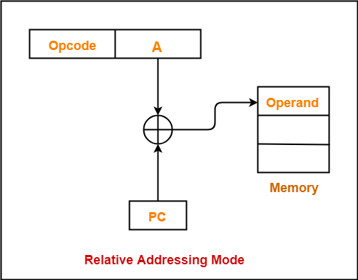

Slide 104
Auto increment mode
A special case of Register Indirect Addressing Mode where
Effective Address of the Operand
= Content of Register
In this addressing mode,
After accessing the operand, the content of the register is automatically incremented by step size ‘d’.
Step size ‘d’ depends on the size of operand accessed.
Only one reference to memory is required to fetch the operand.

Slide 105
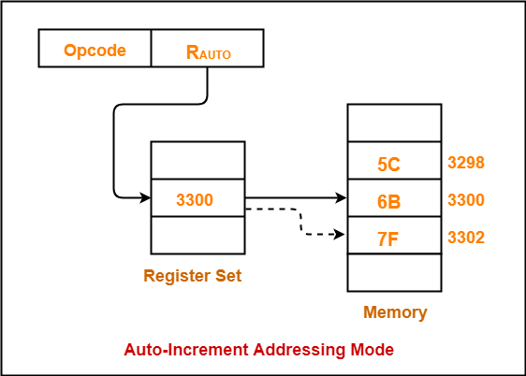

Slide 106
Auto decrement mode
A special case of Register Indirect Addressing Mode where
Effective Address of the Operand
= Content of Register – Step Size
In this addressing mode
First, the content of the register is decremented by step size ‘d’.
Step size ‘d’ depends on the size of operand accessed.
After decrementing, the operand is read.
Only one reference to memory is required to fetch the operand.

Slide 107
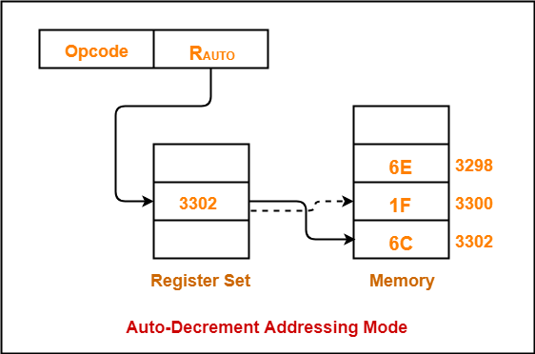

Slide 108
Introduction to Microprocessor

Slide 109
Microprocessors
Microprocessor : It is a semiconductor device consisting of electronic logic circuits. It includes the ALU, register arrays and control circuits on a single chip, it is a CPU on a single chip.
Microcontroller: If a microprocessor contains support circuitry, memory and peripheral I/O components implemented on a single chip, it is a microcontroller.

Slide 110
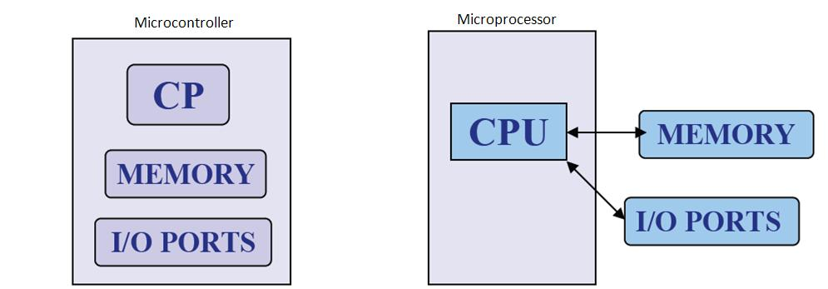
What is Microprocessor and Microcontroller?

Slide 111
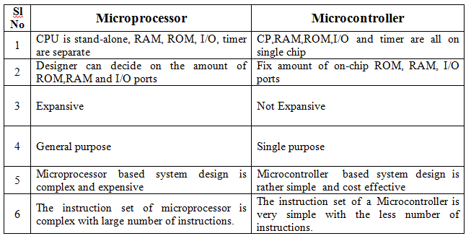

Slide 112
Internal structure and basic operation of microprocessor
ALU
Register Section
Address bus
Data bus
Control and timing section
Control bus
Block diagram of a Microprocessor

Slide 113
Microprocessor performs three main tasks:
data transfer between itself and the memory or I/O systems
simple arithmetic and logic operations
program flow via simple decisions

Slide 114
Microprocessor types
Microprocessors can be characterized based on
the word size
8 bit, 16 bit, 32 bit, etc. processors
Instruction set structure
RISC (Reduced Instruction Set Computer), CISC (Complex Instruction Set Computer)
Functions
General purpose, special purpose such image processing, floating point calculations
And more …

Slide 115
Evolution of Microprocessors
The first microprocessor was introduced in 1971 by Intel Corp.
It was named Intel 4004 as it was a 4 bit processor.
Categories according to the generations or size
First Generation (4 - bit Microprocessors)
could perform simple arithmetic such as addition, subtraction, and logical operations like Boolean OR and Boolean AND.
had a control unit capable of performing control functions like
fetching an instruction from storage memory,
decoding it, and then
generating control pulses to execute it.

Slide 116
Second Generation (8 - bit Microprocessor)
The second generation microprocessors were introduced in 1973 again by Intel.
the first 8 - bit microprocessor which could perform arithmetic and logic operations on 8-bit words.
Third Generation (16 - bit Microprocessor)
introduced in 1978
represented by Intel's 8086, Zilog Z800 and 80286,
16 - bit processors with a performance like minicomputers.

Slide 117
Fourth Generation (32 - bit Microprocessors)
Several different companies introduced the 32-bit microprocessors
the most popular one is the Intel 80386
Fifth Generation (64 - bit Microprocessors)
Introduced in 1995
After 80856, Intel came out with a new processor namely Pentium processor followed by Pentium Pro CPU
allows multiple CPUs in a single system to achieve multiprocessing.
Other improved 64-bit processors are Celeron, Dual, Quad, Octa Core processors.

Slide 118
Typical microprocessors
Most commonly used
68K
Motorola
x86
Intel
IA-64
Intel
MIPS
Microprocessor without interlocked pipeline stages
ARM
Advanced RISC Machine
PowerPC
Apple-IBM-Motorola alliance
Atmel AVR
A brief summary will be given later

Slide 119
8086 Microprocessor
designed by Intel in 1976
16-bit Microprocessor having
20 address lines
16 data lines
provides up to 1MB storage
consists of powerful instruction set, which provides operations like multiplication and division easily.
supports two modes of operation
Maximum mode :
suitable for system having multiple processors
Minimum mode :
suitable for system having a single processor.

Slide 120
Features of 8086
Has an instruction queue, which is capable of storing six instruction bytes
First 16-bit processor having
16-bit ALU
16-bit registers
internal data bus
16-bit external data bus
uses two stages of pipelining
1. Fetch Stage and
2. Execute Stage
which improves performance.
Fetch stage : can pre-fetch up to 6 bytes of instructions and stores them in the queue.
Execute stage : executes these instructions.

Slide 121
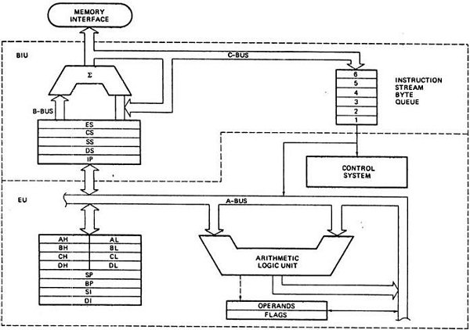
Architecture of 8086

Slide 122
Segments in 8086
memory is divided into various sections called segments
Code segment : where you store the program.
Data segment : where the data is stored.
Extra segment : mostly used for string operations.
Stack segment : used to push/pop

Slide 123
General purpose registers
used to store temporary data within the microprocessor
AX – Accumulator
16 bit register
divided into two 8-bit registers AH and AL
to perform 8-bit instructions also
generally used for arithmetical and logical instructions
BX – Base register
16 bit register
divided into two 8-bit registers BH and BL
to perform 8-bit instructions also
Used to store the value of the offset.

Slide 124
CX – Counter register
16 bit register
divided into two 8-bit registers CH and CL
to perform 8-bit instructions also Used in looping and rotation
DX – Data register
16 bit register
divided into two 8-bit registers DH and DL to
perform 8-bit instructions also Used in multiplication an input/output port addressing

Slide 125
Pointers and Index Registers
SP – Stack pointer
16 bit register
points to the topmost item of the stack
If the stack is empty the stack pointer will be (FFFE)H
It’s offset address relative to stack segment
BP –Base pointer
16 bit register
used in accessing parameters passed by the stack
It’s offset address relative to stack segment

Slide 126
SI – Source index register
16 bit register
used in the pointer addressing of data and
as a source in some string related operations
It’s offset is relative to data segment
DI – Destination index register
16 bit register used in the pointer addressing of data and
as a destination in string related operations
It’s offset is relative to extra segment.

Slide 127
IP - Instruction Pointer
16 bit register
stores the address of the next instruction to be executed
also acts as an offset for CS register.

Slide 128
Segment Registers
CS - Code Segment Register: Contains the starting address of the code segment user cannot modify the content of these registers
Only the microprocessor's compiler can do this
DS - Data Segment Register: Contains the starting address of the data segment. The user can modify the content of the data segment.
SS - Stack Segment Registers: used to store the information about the stack memory segment.
operations of the SS are mainly Push and Pop.
ES - Extra Segment Register: By default, the control of the compiler remains in the DS where the user can add and modify the instructions
If there is less space in that segment, then ES is used
Also used for copying purpose.

Slide 129
Flag or Status Register
16-bit register
contains 9 flags
remaining 7 bits are idle in this register
These flags tell about the status of the processor after any arithmetic or logical operation
IF the flag value is 1, the flag is set, and if it is 0, it is said to be reset.

Slide 130
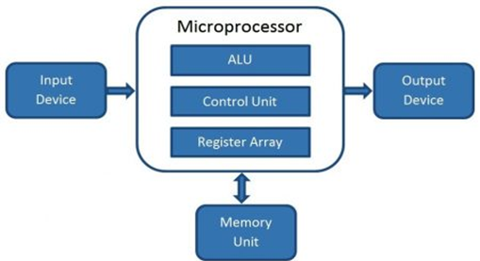
Microcomputer
A digital computer with one microprocessor which acts as a CPU
A complete computer on a small scale, designed for use by one person at a time
called a personal computer (PC)
a device based on a single-chip microprocessor
includes laptops and desktops
Block Diagram

Slide 131
Introduction to 8086 Assembly Language
Assembly Language Programming

Slide 132
Program Statements
Program consist of statement, one per line.
Each statement is either an instruction, which the assembler translate into machine code, or assembler directive, which instructs the assembler to perform some specific task, such as allocating memory space for a variable or creating a procedure.
Both instructions and directives have up to four fields:
At least one blank or tab character must separate the fields
name operation operand(s) comment

Slide 133
Program Statements
An example of an instruction is
START: MOV CX,5 ; initialize counter
The name field consists of the label START:
The operation is MOV, the operands are CX and 5
And the comment is ; initialize counter
name operation operand(s) comment
of An example an assembler directive is
MAIN PROC
MAIN is the name, and the operation field contains PROC
This particular directive creates a procedure called MAIN
name operation operand(s) comment

Slide 134
Program Statements
name operation operand(s) comment
A Name field identifies a label, variable, or symbol.
It may contain any of the following character : A,B…..Z ; a,b….9 ; ? ;
_ (underline) ; @ ; $ ; ,1e . (p….z ; 0riod)
Only the first 31 characters are recognized
There is no distinction between uppercase and lower case letters.
The first character may not be a digit
If it is used, the period ( . ) may be used only as the first character.
A programmer-chosen name may not be the same as an assembler reserved word.

Slide 135
Program Statements
name operation operand(s) comment
Operation field is a predefined or reserved word
mnemonic - symbolic operation code.
The assembler translates a symbolic opcode into a machine language opcode.
Opcode symbols often discribe the operation’s function; for example, MOV, ADD, SUB
assemler directive - pseudo-operation code.
In an assembler directive, the operation field contains a pseudo-operation code (pseudo-op)
Pseudo-op are not translated into machine code; for example the PROC pseudo-op is used to create a procedure

Slide 136
Program Statements
name operation operand(s) comment
An operand field specifies the data that are to be acted on by the operation.
An instruction may have zero, one, or two operands. For example:
NOP No operands; does nothing
INC AX one operand; adds 1 to the contents of AX
ADD R1, 2 two operands; adds 2 to the contents of register R1

Slide 137
Program Statements
name operation operand(s) comment
The comment field is used by the programmer to say something about what the statement does.
A semicolon marks the beginning of this field, and the assembler ignores anything typed after semicolon.
Comments are optional, but because assembly language is low level, it is almost impossible to understand an assembly language program without comments.

Slide 138
Program Data and Storage
Pseudo-ops to define data or reserve storage
DB - byte(s)
DW - word(s)
DD - doubleword(s)
DQ - quadword(s)
DT - tenbyte(s)
These directives require one or more operands
define memory contents
specify amount of storage to reserve for run-time data

Slide 139
Defining Data
Numeric data values
100 - decimal
100B - binary
100H - hexadecimal
'100' - ASCII
"100" - ASCII
Use the appropriate DEFINE directive (byte, word, etc.)
A list of values may be used - the following creates 4 consecutive words
DW 40CH,10B,-13,0
A ? represents an uninitialized storage location
DB 255,?,-128,'X'

Slide 140
Naming Storage Locations
Names can be associated with storage locations
ANum DB -4
DW 17
ONE
UNO DW 1
X DD ?
These names are called variables
ANum refers to a byte storage location, initialized to -4
The next word has no associated name
ONE and UNO refer to the same word
X is an unitialized doubleword

Slide 141
• Multiple definitions can be abbreviated
Example:
message DB ’B’
DB ’y’
DB ’e’
DB 0DH
DB 0AH
can be written as
message DB ’B’,’y’,’e’,0DH,0AH
• More compactly as
message DB ’Bye’,0DH,0AH

Slide 142
Arrays
Any consecutive storage locations of the same size can be called an array
X DW 40CH,10B,-13,0
Y DB 'This is an array'
Z DD -109236, FFFFFFFFH, -1, 100B
Components of X are at X, X+2, X+4, X+6
Components of Y are at Y, Y+1, …, Y+15
Components of Z are at Z, Z+4, Z+8, Z+12

Slide 143
DUP
Allows a sequence of storage locations to be defined or reserved
Only used as an operand of a define directive
DB 40 DUP (?) ; 40 words, uninitialized
DW 10h DUP (0) ; 10 words, initialized as 0
Table1 DW 10 DUP (?) ; 10 words, uninitialized
message DB 3 DUP (’Baby’) ; 12 bytes, initialized
; as BabyBabyBaby
Name1 DB 30 DUP (’?’) ; 30 bytes, each
; initialized to ?

Slide 144
DUP
The DUP directive may also be nested
Example
stars DB 4 DUP(3 DUP (’*’),2 DUP (’?’),5 DUP (’!’))
Reserves 40-bytes space and initializes it as
***??!!!!!***??!!!!!***??!!!!!***??!!!!!
matrix DW 10 DUP (5 DUP (0))
defines a 10X5 matrix and initializes its elements to zero.
This declaration can also be done by
matrix DW 50 DUP (0)

Slide 145
Word Storage

Slide 146
Named Constants
Symbolic names associated with storage locations represent addresses
Named constants are symbols created to represent specific values determined by an expression
Named constants can be numeric or string
Some named constants can be redefined
No storage is allocated for these values

Slide 147
Equal Sign Directive
name = expression
expression must be numeric
these symbols may be redefined at any time
maxint = 7FFFh
count = 1
DW count
count = count * 2
DW count

Slide 148
EQU Directive
name EQU expression
expression can be string or numeric
Use < and > to specify a string EQU
these symbols cannot be redefined later in the program
sample EQU 7Fh
aString EQU <1.234>
message EQU <This is a message>

Slide 149
Data Transfer Instructions
MOV target, source
reg, reg
mem, reg
reg, mem
mem, immed
reg, immed
Sizes of both operands must be the same
reg can be any non-segment register except IP cannot be the target register
MOV's between a segment register and memory or a 16-bit register are possible

Slide 150
Sample MOV Instructions
b db 4Fh
w dw 2048
mov bl,dh
mov ax,w
mov ch,b
mov al,255
mov w,-100
mov b,0
When a variable is created with a define directive, it is assigned a default size attribute (byte, word, etc)
You can assign a size attribute using LABEL
LoByte LABEL BYTE
aWord DW 97F2h

Slide 151
Program Segment Structure
Data Segments
Storage for variables
Variable addresses are computed as offsets from start of this segment
Code Segment
contains executable instructions
Stack Segment
used to set aside storage for the stack
Stack addresses are computed as offsets into this segment
Segment directives
.data
.code
.stack size

Slide 152
Instruction types Data transfer instructions
8086 instruction set
IN Input byte or word from port
LAHF Load AH from flags
LDS Load pointer using data segment
LEA Load effective address
LES Load pointer using extra segment
MOV Move to/from register/memory
OUT Output byte or word to port
POP Pop word off stack
POPF Pop flags off stack
PUSH Push word onto stack
PUSHF Push flags onto stack
SAHF Store AH into flags
XCHG Exchange byte or word
XLAT Translate byte

Slide 153
Arithmetic instructions
8086 instruction set
AAA ASCII adjust for addition
AAD ASCII adjust for division
AAM ASCII adjust for multiply
AAS ASCII adjust for subtraction
ADC Add byte or word plus carry
ADD Add byte or word
CBW Convert byte to word
CMP Compare byte or word
CWD Convert word to double-word
DAA Decimal adjust for addition
DAS Decimal adjust for subtraction
DEC Decrement byte or word by one
DIV Divide byte or word
IDIV Integer divide byte or word
IMUL Integer multiply byte or word
INC Increment byte or word by one
MUL Multiply byte or word (unsigned)
NEG Negate byte or word
SBB Subtract byte or word and carry (borrow)
SUB Subtract byte or word
Additional 80386 instructions
CDQ Convert double-word to quad-word
CWDE Convert word to double-word
Additional 80486 instructions
CMPXCHG Compare and exchange
XADD Exchange and add
Additional Pentium instruction
CMPXCHG8B Compare and exchange 8 bytes

Slide 154
Bit manipulation instructions
8086 instruction set
AND Logical AND of byte or word
NOT Logical NOT of byte or word
OR Logical OR of byte or word
RCL Rotate left trough carry byte or word
RCR Rotate right trough carry byte or word
ROL Rotate left byte or word
ROR Rotate right byte or word
SAL Arithmetic shift left byte or word
SAR Arithmetic shift right byte or word
SHL Logical shift left byte or word
SHR Logical shift right byte or word
TEST Test byte or word
XOR Logical exclusive-OR of byte or word
Additional 80386 instructions
BSF Bit scan forward
BSR Bit scan reverse
BT Bit test
BTC Bit test and complement
BTR Bit test and reset
BTS Bit test and set
SETcc Set byte on condition
SHLD Shift left double precision
SHRD Shift right double precision

Slide 155
String instructions
8086 instruction set
CMPS Compare byte or word string
LODS Load byte or word string
MOVS Move byte or word string
MOVSB(MOVSW) Move byte string (word string)
REP Repeat
REPE (REPZ) Repeat while equal (zero)
REPNE (REPNZ) Repeat while not equal (not zero)
SCAS Scan byte or word string
STOS Store byte or word string

Slide 156
Program Skeleton
.model small
.stack 100H
.data
;declarations
.code
main proc
;code
main endp
;other procs
end main
Select a memory model
Define the stack size
Declare variables
Write code
organize into procedures
Mark the end of the source file
optionally, define the entry point

Slide 157
EXAMPLE : Adding two 8 bit numbers
DATA SEGMENT ; Data Segment
N1 DB 12H
N2 DB 21H
RES DB ?
DATA ENDS
CODE SEGMENT ; Code segment
ASSUME CS: CODE, DS: DATA
START: MOV AX, DATA
MOV DS, AX
MOV AL, N1
MOV BL, N2
ADD AL, BL
MOV RES, AL
INT 21H
CODE ENDS
END START

Slide 158
The ARM Architecture

Slide 159
ARM Ltd
The first ARM processor was developed in the year 1978 by Cambridge University, and the first ARM RISC processor was produced by the Acorn Group of Computers in the year 1985.
An ARM processor is one of a family of CPUs based on the RISC (reduced instruction set computer) architecture developed by Advanced RISC Machines (ARM).
ARM makes 32-bit and 64-bit RISC multi-core processors.
RISC processors are designed to perform a smaller number of computer instructions so that they can operate at a higher speed, performing more millions of instructions per second (MIPS).
By stripping out unneeded instructions and optimizing pathways, RISC processors provide outstanding performance at a fraction of the power demand of CISC (complex instruction set computing) devices.
Notes:
The ARM processor core originates within a British computer company called Acorn. In the mid-1980s they were looking for replacement for the 6502 processor used in their BBC computer range, which were widely used in UK schools. None of the 16-bit architectures becoming available at that time met their requirements, so they designed their own 32-bit processor.
Other companies became interested in this processor, including Apple who were looking for a processor for their PDA project (which became the Newton). After much discussion this led to Acorn’s processor design team splitting off from Acorn at the end of 1990 to become Advanced RISC Machines Ltd, now just ARM Ltd.
Thus ARM Ltd now designs the ARM family of RISC processor cores, together with a range of other supporting technologies.
One important point about ARM is that it does not fabricate silicon itself, but instead just produces the design - we are an Intellectual Property (or IP) company. Instead silicon is produced by companies who license the ARM processor design.

Slide 160
ARM Ltd
ARM processors are extensively used in consumer electronic devices such as smartphones, tablets, multimedia players and other mobile devices, such as wearables.
The ARM processor’s smaller size, reduced complexity and lower power consumption makes them suitable for increasingly miniaturized devices.
ARM processor features include:
Load/store architecture.
An orthogonal instruction set.
Mostly single-cycle execution.
Enhanced power-saving design.
64 and 32-bit execution states for scalable high performance.
Hardware virtualization support.
Notes:
The ARM processor core originates within a British computer company called Acorn. In the mid-1980s they were looking for replacement for the 6502 processor used in their BBC computer range, which were widely used in UK schools. None of the 16-bit architectures becoming available at that time met their requirements, so they designed their own 32-bit processor.
Other companies became interested in this processor, including Apple who were looking for a processor for their PDA project (which became the Newton). After much discussion this led to Acorn’s processor design team splitting off from Acorn at the end of 1990 to become Advanced RISC Machines Ltd, now just ARM Ltd.
Thus ARM Ltd now designs the ARM family of RISC processor cores, together with a range of other supporting technologies.
One important point about ARM is that it does not fabricate silicon itself, but instead just produces the design - we are an Intellectual Property (or IP) company. Instead silicon is produced by companies who license the ARM processor design.

Slide 161
RISC
RISC is an abbreviation of Reduced Instruction Set Computer.
RISC processor has ‘instruction sets’ that are simple and have simple ‘addressing modes’.
A RISC style instruction engages “one word” in memory.
Execution of the RISC instructions are faster and take one clock cycle per instruction.
RISC architecture emphasizes on using the registers rather than memory.
The RISC instructions operate on the operands present in processor’s registers.
RISC is a type of microprocessor architecture that utilizes a small, highly-optimized set of instructions, rather than a more specialized set of instructions often found in other types of architectures.

Slide 162
ARM Processor Architecture
The ARM architecture processor is an advanced reduced instruction set computing [RISC] machine and it’s a 32bit reduced instruction set computer (RISC) microcontroller.
It was introduced by the Acron computer organization in 1987.
This ARM is a family of microcontroller developed by makers like ST Microelectronics, Motorola, and so on.
The ARM architecture comes with totally different versions like ARMv1, ARMv2, etc., and, each one has its own advantage and disadvantages.
The ARM cortex is a complicated microcontroller within the ARM family that has ARMv7 design.
There are 3 subfamilies within the ARM cortex family :
ARM Cortex Ax-series
ARM-Cortex Rx-series
ARM-Cortex Mx-series
Notes:
ARM’s business model centres around the principle of partnership. At the centre of this are ARM’s semiconductor partners who design, manufacture and market ARM-compliant products.
Having so many partner companies producing silicon executing the same instruction set is a very important part of ARM’s strength in the market place.
However each of our semiconductor partners bring their own unique strengths to the partnership - each having their own technologies, applications knowledge, product focus, culture, geography, and key customers.
In addition to our partnering with semiconductor companies, we also partner with a large number of other third parties to ensure that operating systems, EDA and software development tools, application software and design services are available for doing ARM based designs.
“ATAP” stands for ARM Technology Access Program. Creates a network of independent design service companies and equips them to deliver ARM-powered designs. Members get access to ARM technology, expertise and support. Members sometimes referred to as “Approved Design Centers”.

Slide 163
Data Sizes and Instruction Sets
The ARM is a 32-bit architecture.
When used in relation to the ARM:
Byte means 8 bits
Halfword means 16 bits (two bytes)
Word means 32 bits (four bytes)
Most ARM’s implement two instruction sets
32-bit ARM Instruction Set
16-bit Thumb Instruction Set
Jazelle cores can also execute Java bytecode
Notes:
The cause of confusion here is the term “word” which will mean 16-bits to people with a 16-bit background.
In the ARM world 16-bits is a “halfword” as the architecture is a 32-bit one, whereas “word” means 32-bits.
Java bytecodes are 8-bit instructions designed to be architecture independent. Jazelle transparently executes most bytecodes in hardware and some in highly optimized ARM code. This is due to a tradeoff between hardware complexity (power consumption & silicon area) and speed.

Slide 164
Processor Modes
The ARM has seven basic operating modes:
User : unprivileged mode under which most tasks run
FIQ : entered when a high priority (fast) interrupt is raised
IRQ : entered when a low priority (normal) interrupt is raised
Supervisor : entered on reset and when a Software Interrupt
instruction is executed
Abort : used to handle memory access violations
Undef : used to handle undefined instructions
System : privileged mode using the same registers as user mode
Notes:
The Programmers Model can be split into two elements - first of all, the processor modes and secondly, the processor registers. So let’s start by looking at the modes.
Now the typical application will run in an unprivileged mode know as “User” mode, whereas the various exception types will be dealt with in one of the privileged modes : Fast Interrupt, Supervisor, Abort, Normal Interrupt and Undefined (and we will look at what causes each of the exceptions later on).
NB - spell out the word FIQ, otherwise you are saying something rude in German!
One question here is what is the difference between the privileged and unprivileged modes? Well in reality very little really - the ARM core has an output signal (nTRANS on ARM7TDMI, InTRANS, DnTRANS on 9, or encoded as part of HPROT or BPROT in AMBA) which indicates whether the current mode is privileged or unprivileged, and this can be used, for instance, by a memory controller to only allow IO access in a privileged mode. In addition some operations are only permitted in a privileged mode, such as directly changing the mode and enabling of interrupts.
All current ARM cores implement system mode (added in architecture v4). This is simply a privileged version of user mode. Important for re-entrant exceptions because no exceptions can cause system mode to be entered.

Slide 165
The Registers
ARM has 37 registers all of which are 32-bits long.
1 dedicated program counter
1 dedicated current program status register
5 dedicated saved program status registers
30 general purpose registers
The current processor mode governs which of several banks is accessible. Each mode can access
a particular set of r0-r12 registers
a particular r13 (the stack pointer, sp) and r14 (the link register, lr)
the program counter, r15 (pc)
the current program status register, cpsr
Privileged modes (except System) can also access
a particular spsr (saved program status register)
Notes:
The ARM architecture provides a total of 37 registers, all of which are 32-bits long. However these are arranged into several banks, with the accessible bank being governed by the current processor mode. We will see this in more detail in a couple of slides. In summary though, in each mode, the core can access:
a particular set of 13 general purpose registers (r0 - r12).
a particular r13 - which is typically used as a stack pointer. This will be a different r13 for each mode, so allowing each exception type to have its own stack.
a particular r14 - which is used as a link (or return address) register. Again this will be a different r14 for each mode.
r15 - whose only use is as the Program counter.
The CPSR (Current Program Status Register) - this stores additional information about the state of the processor:
And finally in privileged modes, a particular SPSR (Saved Program Status Register). This stores a copy of the previous CPSR value when an exception occurs. This combined with the link register allows exceptions to return without corrupting processor state.

Slide 166
Register Organization Summary
User
FIQ
IRQ
SVC
Undef
Abort
r0
User mode r0-r7, r15, and cpsr
User mode r0-r12, r15, and cpsr
User mode r0-r12, r15, and cpsr
User mode r0-r12, r15, and cpsr
User mode r0-r12, r15, and cpsr
r1
r2
r3
r4
Thumb state
Low registers
r5
r6
r7
r8
r8
r9
r9
r10
r10
Thumb state
High registers
r11
r11
r12
r12
r13 (sp)
r13 (sp)
r13 (sp)
r13 (sp)
r13 (sp)
r13 (sp)
r14 (lr)
r14 (lr)
r14 (lr)
r14 (lr)
r14 (lr)
r14 (lr)
r15 (pc)
cpsr
spsr
spsr
spsr
spsr
spsr
Note: System mode uses the User mode register set
Notes:
This slide shows the registers visible in each mode - basically in a more static fashion than the previous animated slide that is more useful for reference.
The main point to state here is the splitting of the registers in Thumb state into Low and High registers.
ARM register banking is the minimum necessary for fast handling of overlapping exceptions of different types (e.g. ABORT during SWI during IRQ). For nested exceptions of the same type (e.g. re-entrant interrupts) some additional pushing of registers to the stack is required.

Slide 167
The ARM Register Set
Current Visible Registers
Current Visible Registers
Current Visible Registers
Current Visible Registers
Current Visible Registers
r0
r0
r0
r0
r0
SVC Mode
r0
Undef Mode
FIQ Mode
User Mode
IRQ Mode
r1
r1
r1
r1
r1
r1
Abort Mode
r0
r2
r2
r2
r2
r2
r2
Banked out Registers
Banked out Registers
Banked out Registers
Banked out Registers
r1
Banked out Registers
r3
r3
r3
r3
r3
r3
r2
r4
r4
r4
r4
r4
r4
Banked out Registers
r3
r5
r5
r5
r5
r5
r5
r4
User
User
User
User
FIQ
FIQ
FIQ
FIQ
FIQ
IRQ
IRQ
IRQ
IRQ
IRQ
SVC
SVC
SVC
SVC
SVC
Undef
Undef
Undef
Undef
Undef
Abort
Abort
Abort
Abort
Abort
r6
Abort
r6
r6
r6
r6
r6
r5
r7
r7
r7
r7
r7
r7
User
FIQ
IRQ
SVC
Undef
r6
r8
r8
r8
r8
r8
r8
r8
r8
r8
r8
r8
r7
r8
r9
r9
r9
r9
r9
r9
r9
r9
r9
r9
r9
r8
r9
r10
r8
r10
r10
r10
r10
r10
r10
r10
r10
r10
r10
r9
r10
r11
r9
r11
r11
r11
r11
r11
r11
r11
r11
r11
r11
r10
r11
r12
r10
r12
r12
r12
r12
r12
r12
r12
r12
r12
r12
r11
r12
r13 (sp)
r11
r13 (sp)
r13 (sp)
r13 (sp)
r13 (sp)
r13 (sp)
r13 (sp)
r13 (sp)
r13 (sp)
r13 (sp)
r13 (sp)
r13 (sp)
r13 (sp)
r13 (sp)
r13 (sp)
r13 (sp)
r13 (sp)
r13 (sp)
r13 (sp)
r13 (sp)
r13 (sp)
r13 (sp)
r13 (sp)
r13 (sp)
r13 (sp)
r13 (sp)
r13 (sp)
r13 (sp)
r13 (sp)
r13 (sp)
r13 (sp)
r13 (sp)
r13 (sp)
r13 (sp)
r13 (sp)
r12
r12
r13 (sp)
r14 (lr)
r14 (lr)
r14 (lr)
r14 (lr)
r14 (lr)
r14 (lr)
r14 (lr)
r14 (lr)
r14 (lr)
r14 (lr)
r14 (lr)
r14 (lr)
r14 (lr)
r14 (lr)
r14 (lr)
r14 (lr)
r14 (lr)
r14 (lr)
r14 (lr)
r14 (lr)
r14 (lr)
r14 (lr)
r14 (lr)
r14 (lr)
r14 (lr)
r14 (lr)
r14 (lr)
r14 (lr)
r14 (lr)
r14 (lr)
r14 (lr)
r14 (lr)
r14 (lr)
r14 (lr)
r14 (lr)
r13 (sp)
r13 (sp)
r13 (sp)
r13 (sp)
r13 (sp)
r13 (sp)
r14 (lr)
r15 (pc)
r15 (pc)
r15 (pc)
r15 (pc)
r15 (pc)
r15 (pc)
r14 (lr)
r14 (lr)
r14 (lr)
r14 (lr)
r14 (lr)
r14 (lr)
r15 (pc)
cpsr
cpsr
cpsr
cpsr
cpsr
cpsr
spsr
spsr
spsr
spsr
spsr
spsr
spsr
spsr
spsr
spsr
spsr
spsr
spsr
spsr
spsr
spsr
spsr
spsr
spsr
spsr
spsr
spsr
spsr
spsr
spsr
spsr
spsr
spsr
spsr
cpsr
spsr
spsr
spsr
spsr
spsr
spsr
Notes:
This animated slide shows the way that the banking of registers works. On the left the currently visible set of registers are shown for a particular mode.
On the right are the registers that are banked out whilst in that mode.
Each key press will switch mode:
user -> FIQ ->user -> IRQ -> user ->SVC -> User -> Undef -> User -> Abort and then back to user.
The following slide then shows this in a more static way that is more useful for reference

Slide 168
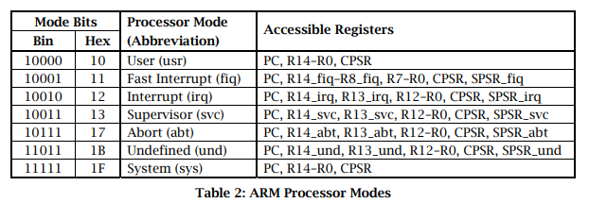
Mode Bits

Slide 169
Program Counter (r15)
When the processor is executing in ARM state:
All instructions are 32 bits wide
All instructions must be word aligned
Therefore the pc value is stored in bits [31:2] with bits [1:0] undefined (as instruction cannot be halfword or byte aligned).
When the processor is executing in Thumb state:
All instructions are 16 bits wide
All instructions must be halfword aligned
Therefore the pc value is stored in bits [31:1] with bit [0] undefined (as instruction cannot be byte aligned).
When the processor is executing in Jazelle state:
All instructions are 8 bits wide
Processor performs a word access to read 4 instructions at once
Notes:
ARM is designed to efficiently access memory using a single memory access cycle. So word accesses must be on a word address boundary, halfword accesses must be on a halfword address boundary. This includes instruction fetches.
Point out that strictly, the bottom bits of the PC simply do not exist within the ARM core - hence they are ‘undefined’. Memory system must ignore these for instruction fetches.
In Jazelle state, the processor doesn’t perform 8-bit fetches from memory. Instead it does aligned 32-bit fetches (4-byte prefetching) which is more efficient. Note we don’t mention the PC in Jazelle state because the ‘Jazelle PC’ is actually stored in r14 - this is technical detail that is not relevant as it is completely hidden by the Jazelle support code.

Slide 170
Arithmetic Logic Unit (ALU)
The ALU has two 32-bits inputs. The primary input comes from the register file, whereas the other input comes from the shifter.
Status registers flags modified by the ALU outputs.
Notes:
ARM’s business model centres around the principle of partnership. At the centre of this are ARM’s semiconductor partners who design, manufacture and market ARM-compliant products.
Having so many partner companies producing silicon executing the same instruction set is a very important part of ARM’s strength in the market place.
However each of our semiconductor partners bring their own unique strengths to the partnership - each having their own technologies, applications knowledge, product focus, culture, geography, and key customers.
In addition to our partnering with semiconductor companies, we also partner with a large number of other third parties to ensure that operating systems, EDA and software development tools, application software and design services are available for doing ARM based designs.
“ATAP” stands for ARM Technology Access Program. Creates a network of independent design service companies and equips them to deliver ARM-powered designs. Members get access to ARM technology, expertise and support. Members sometimes referred to as “Approved Design Centers”.

Slide 171
Booth algorithm
Booth algorithm is a noteworthy multiplication algorithmic rule for 2’s complement numbers.
This treats positive and negative numbers uniformly.
Moreover, the runs of 0’s or 1’s within the multiplier factor are skipped over without any addition or subtraction being performed, thereby creating possible quicker multiplication.
It’s clear that the multiplication finishes only in16 clock cycle.
Notes:
ARM’s business model centres around the principle of partnership. At the centre of this are ARM’s semiconductor partners who design, manufacture and market ARM-compliant products.
Having so many partner companies producing silicon executing the same instruction set is a very important part of ARM’s strength in the market place.
However each of our semiconductor partners bring their own unique strengths to the partnership - each having their own technologies, applications knowledge, product focus, culture, geography, and key customers.
In addition to our partnering with semiconductor companies, we also partner with a large number of other third parties to ensure that operating systems, EDA and software development tools, application software and design services are available for doing ARM based designs.
“ATAP” stands for ARM Technology Access Program. Creates a network of independent design service companies and equips them to deliver ARM-powered designs. Members get access to ARM technology, expertise and support. Members sometimes referred to as “Approved Design Centers”.

Slide 172
Control Unit
For any microprocessor, control unit is the heart of the whole process and it is responsible for the system operation, so the control unit design is the most important part within the whole design.
The control unit is sometimes a pure combinational circuit design.
Here, the control unit is implemented by easy state machine.
The processor timing is additionally included within the control unit.
Signals from the control unit are connected to each component within the processor to supervise its operation.
Notes:
ARM’s business model centres around the principle of partnership. At the centre of this are ARM’s semiconductor partners who design, manufacture and market ARM-compliant products.
Having so many partner companies producing silicon executing the same instruction set is a very important part of ARM’s strength in the market place.
However each of our semiconductor partners bring their own unique strengths to the partnership - each having their own technologies, applications knowledge, product focus, culture, geography, and key customers.
In addition to our partnering with semiconductor companies, we also partner with a large number of other third parties to ensure that operating systems, EDA and software development tools, application software and design services are available for doing ARM based designs.
“ATAP” stands for ARM Technology Access Program. Creates a network of independent design service companies and equips them to deliver ARM-powered designs. Members get access to ARM technology, expertise and support. Members sometimes referred to as “Approved Design Centers”.

Slide 173
Program Status Registers
31
28
27
24
23
16
15
8
7
6
5
4
0
J
I F T mode
N Z C V Q
U n d e f i n e d
f
s
x
c
Condition code flags
N = Negative result from ALU
Z = Zero result from ALU
C = ALU operation Carried out
V = ALU operation oVerflowed
Sticky Overflow flag - Q flag
Architecture 5TE/J only
Indicates if saturation has occurred
Bit[27] of the CPSR is a sticky overflow flag, also known as the Q flag. This flag is set to 1 if any of the following occurs:
Saturation of the addition result in a QADD or QDADD instruction.
Saturation of the subtraction result in a QSUB or QDSUB instruction.
J bit
Architecture 5TEJ only
J = 1: Processor in Jazelle state
Interrupt Disable bits.
I = 1: Disables the IRQ.
F = 1: Disables the FIQ.
T Bit
Architecture xT only
T = 0: Processor in ARM state
T = 1: Processor in Thumb state
Mode bits
Specify the processor mode
Notes:
Green psr bits are only in certain versions of the ARM architecture
ALU status flags (set if "S" bit set, implied in Thumb state).
Sticky overflow flag (Q flag) is set either when
saturation occurs during QADD, QDADD, QSUB or QDSUB, or
the result of SMLAxy or SMLAWx overflows 32-bits
Once flag has been set can not be modified by one of the above instructions and must write to CPSR using MSR instruction to cleared
PSRs split into four 8-bit fields that can be individually written:
Control (c) bits 0-7
Extension (x) bits 8-15 Reserved for future use
Status (s) bits 16-23 Reserved for future use
Flags (f) bits 24-31
Bits that are reserved for future use should not be modified by current software. Typically, a read-modify-write strategy should be used to update the value of a status register to ensure future compatibility. Note that the T/J bits in the CPSR should never be changed directly by writing to the PSR (use the BX/BXJ instruction to change state instead).
However, in cases where the processor state is known in advance (e.g. on reset, following an interrupt, or some other exception), an immediate value may be written directly into the status registers, to change only specific bits (e.g. to change mode).
New ARM V6 bits now shown.

Slide 174
Exception Handling
When an exception occurs, the ARM:
Copies CPSR into SPSR_<mode>
Sets appropriate CPSR bits
Change to ARM state
Change to exception mode
Disable interrupts (if appropriate)
Stores the return address in
LR_<mode>
Sets PC to vector address
To return, exception handler needs to:
Restore CPSR from SPSR_<mode>
Restore PC from LR_<mode>
This can only be done in ARM state.
0x1C
FIQ
0x18
IRQ
0x14
(Reserved)
0x10
Data Abort
0x0C
Prefetch Abort
0x08
Software Interrupt
0x04
Undefined Instruction
0x00
Reset
Vector Table
Vector table can be at 0xFFFF0000 on ARM720T and on ARM9/10 family devices
Notes:
Exception handling on the ARM is controlled through the use of an area of memory called the vector table. This lives (normally) at the bottom of the memory map from 0x0 to 0x1c. Within this table one word is allocated to each of the various exception types.
This word will contain some form of ARM instruction that should perform a branch. It does not contain an address.
Reset - executed on power on
Undef - when an invalid instruction reaches the execute stage of the pipeline
SWI - when a software interrupt instruction is executed
Prefetch - when an instruction is fetched from memory that is invalid for some reason, if it reaches the execute stage then this exception is taken
Data - if a load/store instruction tries to access an invalid memory location, then this exception is taken
IRQ - normal interrupt
FIQ - fast interrupt
When one of these exceptions is taken, the ARM goes through a low-overhead sequence of actions in order to invoke the appropriate exception handler. The current instruction is always allowed to complete (except in case of Reset).
IRQ is disabled on entry to all exceptions; FIQ is also disabled on entry to Reset and FIQ.

Slide 175
link register (LR or R14)
The link register (LR or R14) is a core register that stores the return address, such as when making a function call.
In the case of an exception, the return address is pushed onto the stack by hardware and the LR is set to EXC_RETURN

Slide 176
Conditional Execution and Flags
ARM instructions can be made to execute conditionally by postfixing them with the appropriate condition code field.
This improves code density and performance by reducing the number of forward branch instructions.
CMP r3,#0 CMP r3,#0 BEQ skip ADDNE r0,r1,r2 ADD r0,r1,r2 skip
Notes:
Unusual but powerful feature of the ARM instruction set. Other architectures normally only have conditional branches.
Some recently-added ARM instructions (in v5T and v5TE) are not conditional (e.g. v5T BLX offset)
Core compares condition field in instruction against NZCV flags to determine if instruction should be executed.

Slide 177
Condition Codes
The possible condition codes are listed below:
Note AL is the default and does not need to be specified
Suffix
Description
Flags tested
EQ
Equal
Z=1
NE
Not equal
Z=0
CS/HS
Unsigned higher or same
C=1
CC/LO
Unsigned lower
C=0
MI
Minus
N=1
PL
Positive or Zero
N=0
VS
Overflow
V=1
VC
No overflow
V=0
HI
Unsigned higher
C=1 & Z=0
LS
Unsigned lower or same
C=0 or Z=1
GE
Greater or equal
N=V
LT
Less than
N!=V
GT
Greater than
Z=0 & N=V
LE
Less than or equal
Z=1 or N=!V
AL
Always
Notes:
Condition codes are simply a way of testing the ALU status flags.

Slide 178
Examples of conditional execution
Use a sequence of several conditional instructions
if (a==0) func(1);
CMP r0,#0 MOVEQ r0,#1 BLEQ func
if (a==0) x=0; if (a>0) x=1;
CMP r0,#0 MOVEQ r1,#0 MOVGT r1,#1
Use conditional compare instructions
if (a==4 || a==10) x=0;
CMP r0,#4 CMPNE r0,#10 MOVEQ r1,#0
Notes:
Sequence of conditional instructions:
- no instruction must reset cond code flags
- BL corrupts flags so must be last
- limit sequence to max 3 or so instrs
Can use different condition codes. Give if then else example. Note GCD practical coming later.
Conditional compare
- resets condition code when executed
- compiler will make use of this
- can be difficult for a human to understand!
Not just for compare, using data processing with condition code and S bit is useful in some circumstances.
LDM/LDR instruction cannot set flags due to datapath issues (data comes back only at the very end of the cycle, so there is no opportunity to perform a comparison and set the status flags).

Slide 179
Branch instructions
Branch : B{<cond>} label
Branch with Link : BL{<cond>} subroutine_label
Branch with link (BL) copies the address of the next instruction (after the BL) into the link register. The branch instruction doesn't. BL would be used for a subroutine call.
31
28
27
25
24
23
0
Cond 1 0 1 L Offset
Link bit 0 = Branch
1 = Branch with link
Condition field
Notes:
PC-relative to allow position independent code, and allows restricted branch range to jump to nearby addresses.
How to access full 32-bit address space? Can set up LR manually if needed, then load into PC
MOV lr, pc
LDR pc, =dest
ADS linker will automatically generate long branch veneers for branches beyond 32Mb range.

Slide 180
Data processing Instructions
Consist of :
Arithmetic: ADD ADC SUB SBC RSB RSC
Logical: AND ORR EOR BIC
Comparisons: CMP CMN TST TEQ
Data movement: MOV MVN
The BIC (Bit Clear) instruction performs an AND operation on the bits in Rn with the complements of the corresponding bits in the value of Operand2
EOR: bit 0 of the <lhs> is EORed with bit 0 of the <rhs> and stored in bit 0 of the <dest> , and so on. The EOR instruction is often used to invert the state of certain bits of a register without affecting the rest.
The TST instruction performs a bitwise AND operation on the value in Rn and the value of Operand2
The TEQ instruction performs a bitwise Exclusive OR operation on the value in Rn and the value of Operand2
The MVN instruction takes the value of Operand2 , performs a bitwise logical NOT operation on the value, and places the result into Rd
These instructions only work on registers, NOT memory.
Second operand is sent to the ALU via barrel shifter.
Notes:
BIC bit clear
ORR bit set
AND bit mask
EOR bit invert
Comparisons produce no results - just set condition codes.
CMP like SUB
CMN like ADD (subtract of a negative number is the same as add)
TST like AND
TEQ like EOR (eor of identical numbers gives result of zero)
Generally single-cycle execution (except write to PC and register-controlled shift). Mention ARM NOP & Thumb NOP.
Explain RSB and RSC which do subtract in other order (e.g. y-x not x-y)
Does not include multiply (separate instr format). No divide - compiler uses run-time library or barrel shifter to perform division.
Can combine “S” bit with conditional execution, e.g.
ADDEQS r0, r1, r2

Slide 181
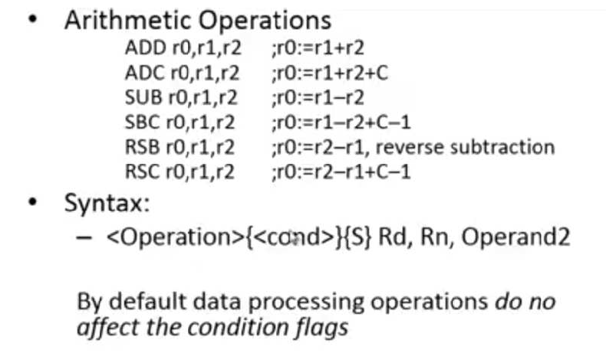
EXAMPLE

Slide 182
EXAMPLE

Slide 183
Barrel Shifter & Memory Instructions

Slide 184
The Barrel Shifter
LSL : Logical Left Shift
ASR: Arithmetic Right Shift
CF
Destination
0
Destination
CF
Multiplication by a power of 2
Division by a power of 2, preserving the sign bit
LSR : Logical Shift Right
ROR: Rotate Right
...0
Destination
CF
Destination
CF
Division by a power of 2
Bit rotate with wrap around from LSB to MSB
RRX: Rotate Right Extended
Destination
CF
Single bit rotate with wrap around from CF to MSB
Notes:
Rotate left can be implemented as rotate right (32-number), e.g. rotate left of 10 is performed using rotate right of 22.
RRX shifts by 1 bit position, of a 33 bit amount (includes carry flag). Very specialized application (e.g. encryption algorithms). Cannot be generated by C compiler. We have used it for 64/64 bit divide. RRX allows you to shift multiprecision values right by one efficiently. Also used in ARM’s MPEG code in a very tricky piece of code.
ANSI C does not have a rotate operation (it only has “<<“ and “>>” which are the equivalent of LSL, LSR and ASR). However the ARM compiler recognizes rotate type expresssions and optimizes these to use ROR, e.g.
int f(unsigned int a)
{
return (a << 10) | (a >>22) ;
}
=> MOV a1,a1,ROR #22
Carry flag set out of the shifter for *logical* data processing operations

Slide 185
Using the Barrel Shifter: The Second Operand
Operand 1
Operand 2
Barrel Shifter
ALU
Result
Notes:
Mention A bus and B bus on 7TDMI core.
Give examples:
ADD r0, r1, r2
ADD r0, r1, r2, LSL#7
ADD r0, r1, r2, LSL r3
ADD r0, r1, #0x4E

Slide 186
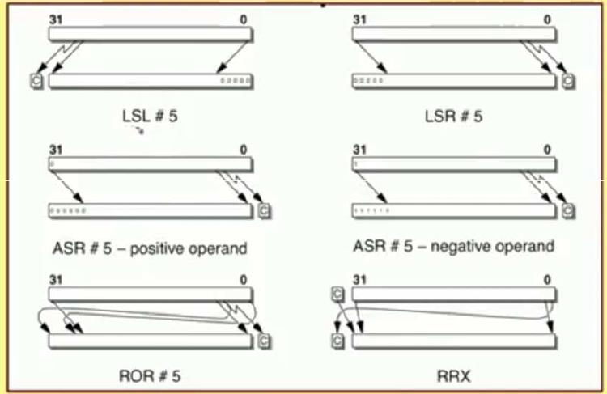
EXAMPLE

Slide 187
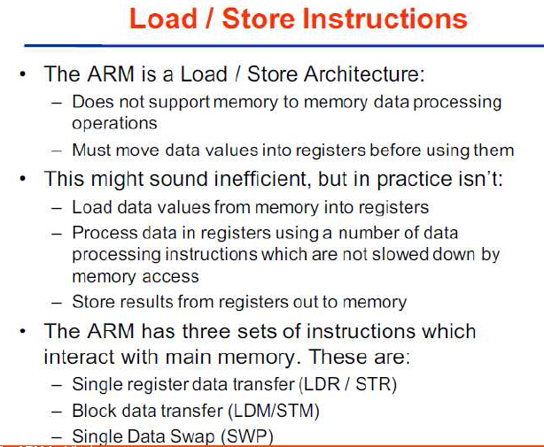

Slide 188
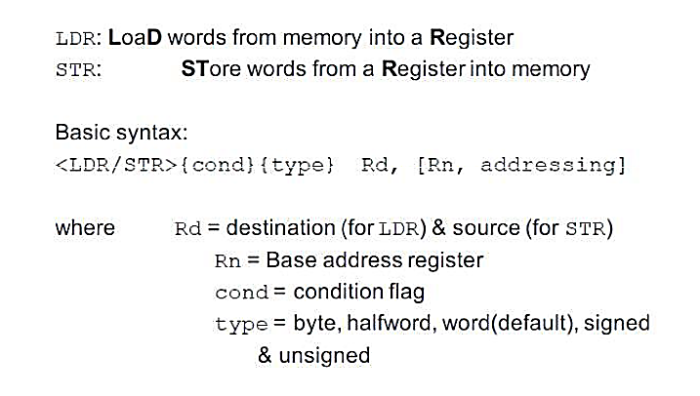
Single register data transfer
Notes:
Point out destination (reg) first for LDR, but destination (mem) last for STR. Different to Motorola, but it keeps the instruction mnemonic format consistent. Always have register loaded/stored first, then address accessed second
Size specifier comes out on MAS (memory access size) signal. Important that memory supports full range of accesses - especially important for writes where only the specified size should be written.
Special types of sign extended load - this is needed because ARM registers only hold 32-bit values. Draw diagram. No need for special store instructions though.
Instruction cycle timing:
STR LDR
7TDMI 2 cycles 3 cycles
9TDMI 1 cycle 1 cycle - interlock if used in next cycle
StrongARM1 1 cycle 1 cycle - interlock if used in next cycle
Xscale 1 cycle 1 cycle - interlock if used in next 2 cycles
Note size specifier comes after condition code.
Link: <address> explained on next slide.
Note that load/store instructions never set condition codes.

Slide 189
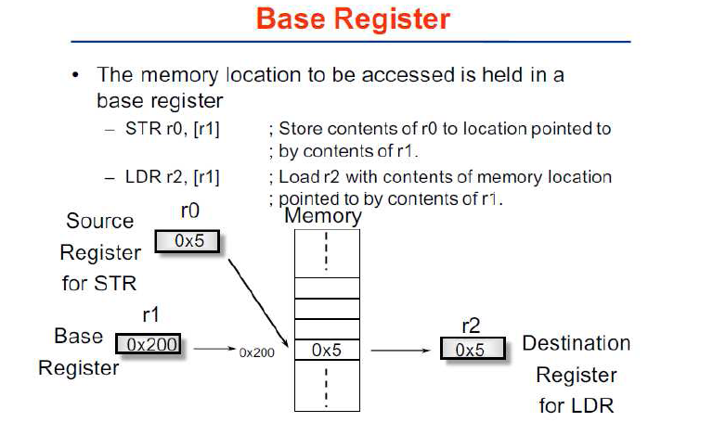

Slide 190
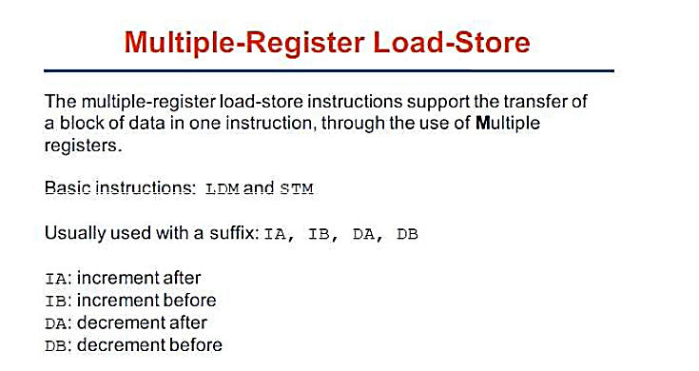
(LDM/STM)

Slide 191
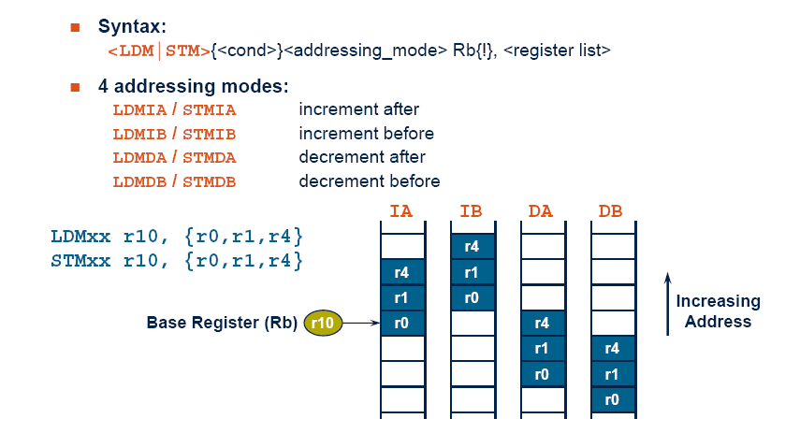
(LDM/STM) Operations

Slide 192
Software Interrupt (SWI)
31
28
27
24
23
0
Cond 1 1 1 1
SWI number (ignored by processor)
Condition Field
Causes an exception trap to the SWI hardware vector
The SWI handler can examine the SWI number to decide what operation has been requested.
By using the SWI mechanism, an operating system can implement a set of privileged operations which applications running in user mode can request.
Syntax:
SWI{<cond>} <SWI number>
Notes:
In effect, a SWI is a user-defined instruction.
Used for calling the operating system (switches to privileged mode).
SWI number field can be used to specify the operation code, e.g. SWI 1 start a new task, SWI 2 allocate memory, etc. Using a number has the advantage that the O.S. can have different revisions, and the same application code will work on each O.S. rev.

Slide 193
Example ARM-based System
32 bit RAM
Peripherals
16 bit RAM
Interrupt
Controller
I/O
nIRQ
nFIQ
ARM
Core
8 bit ROM
Notes:
This slides shows a very generic ARM based design, that is actually fairly representative of the designs that we see being done.
On-chip there will be an ARM core (obviously) together with a number of system dependant peripherals. Also required will be some form of interrupt controller which receives interrupts from the peripherals and raised the IRQ or FIQ input to the ARM as appropriate. This interrupt controller may also provide hardware assistance for prioritizing interrupts.
As far as memory is concerned there is likely to be some (cheap) narrow off-chip ROM (or flash) used to boot the system from. There is also likely to be some 16-bit wide RAM used to store most of the runtime data and perhaps some code copied out of the flash. Then on-chip there may well be some 32-bit memory used to store the interrupt handlers and perhaps stacks.

Slide 194
Basics of Input - Output Operations

Slide 195
Input - Output Interface
Input Output Interface provides a method for transferring information between internal storage and external I/O devices. Peripherals connected to a computer need special communication links for interfacing them with the central processing unit.

Slide 196
Input - Output Interface
The purpose of communication link is to resolve the differences that exist between the central computer and each peripheral.

Slide 197
The Major Differences are:-
Peripherals are electro-mechanical and electromagnetic devices and their manner of operation of the CPU and memory, which are electronic devices. Therefore, a conversion of signal values may be needed.
The data transfer rate of peripherals is usually slower than the transfer rate of CPU and consequently, a synchronization mechanism may be needed.

Slide 198
The Major Differences are:-
Data codes and formats in the peripherals differ from the word format in the CPU and memory.
The operating modes of peripherals are different from each other and must be controlled so as not to disturb the operation of other peripherals connected to the CPU.

Slide 199
Input - Output Interface
To Resolve these differences, computer systems include special hardware components between the CPU and Peripherals to supervises and synchronizes all input and out transfers. These components are called Interface Units because they interface between the processor bus and the peripheral devices.

Slide 200
I/O BUS and Interface Module
It defines the typical link between the processor and several peripherals. The I/O Bus consists of data lines, address lines and control lines.
The I/O bus from the processor is attached to all peripherals interface. To communicate with a particular device, the processor places a device address on address lines.

Slide 201
I/O BUS and Interface Module
Each Interface decodes the address and control received from the I/O bus, interprets them for peripherals and provides signals for the peripheral controller.
It is also synchronizes the data flow and supervises the transfer between peripheral and processor. Each peripheral has its own controller. For example, the printer controller controls the paper motion, the print timing.

Slide 202
I/O BUS and Interface Module
The control lines are referred as an I/O command. The commands are as following:
Control command- A control command is issued to activate the peripheral and to inform it what to do.
Status command- A status command is used to test various status conditions in the interface and the peripheral.

Slide 203
I/O BUS and Interface Module
Output data command-
A data output command causes the interface to respond by transferring data from the bus into one of its registers.
Input data command-
The data input command is the opposite of the data output. In this case the interface receives on item of data from the peripheral and places it in its buffer register.

Slide 204
I/O BUS and Interface Module
Data
Processor
Address
Control
Interface
Interface
Interface
Keyboard and display terminal
Printer
Magnetic disk
Connection of I/O bus to input-output devices

Slide 205
I/O Versus Memory Bus
There are 3 ways that computer buses can be used to communicate with memory and I/O:
i. Use two Separate buses , one for memory and other for I/O.
ii. Use one common bus for both memory and I/O but separate control lines for each.
iii. Use one common bus for memory and I/O with common control lines.

